Slide 1
The Belt and Road Accreditation Development International Workshop Program
Pakistan National Accreditation Council (PNAC)
Engr. Muhammad Imran

Slide 2
Scheme of Presentation
Establishment
Organization’s structure
Functions of PNAC
International Linkage
MSTQ in Pakistan
Achievement
Accredited CABs
One Belt and Road Accreditation Initiative
Future plan
Pakistan National Accreditation Council

Slide 3
PNAC History
Establishment 1998
Enabling legislation 2017
Pakistan National Accreditation Council

Slide 4
Organization’s structure
Pakistan National Accreditation Council

Slide 5
Functions of PNAC
Present Accreditation Schemes:
Testing & Cal. Laboratories (ISO/IEC 17025) (MRA)-2009
Certification Bodies (ISO/IEC 17021) (MLA)-2013
Product Certification (ISO/IEC 17065) (MLA)-2017
Halal Certification Bodies (PS 4992:2010)
Pakistan National Accreditation Council

Slide 6
Functions of PNAC
Present Accreditation Schemes:
Inspection Bodies (ISO/IEC 17020)
Medical Laboratories (ISO 15189)
Proficiency Testing (ISO/IEC 17043)
Personnel Certification (ISO/IEC 17024)
Pakistan National Accreditation Council

Slide 7
Functions of PNAC
Future Accreditation Schemes:
Good Laboratory Practices (GLP)
Food Safety Management System (FSMS)
Green House Gases
Other emerging accreditation fields
Pakistan National Accreditation Council

Slide 8
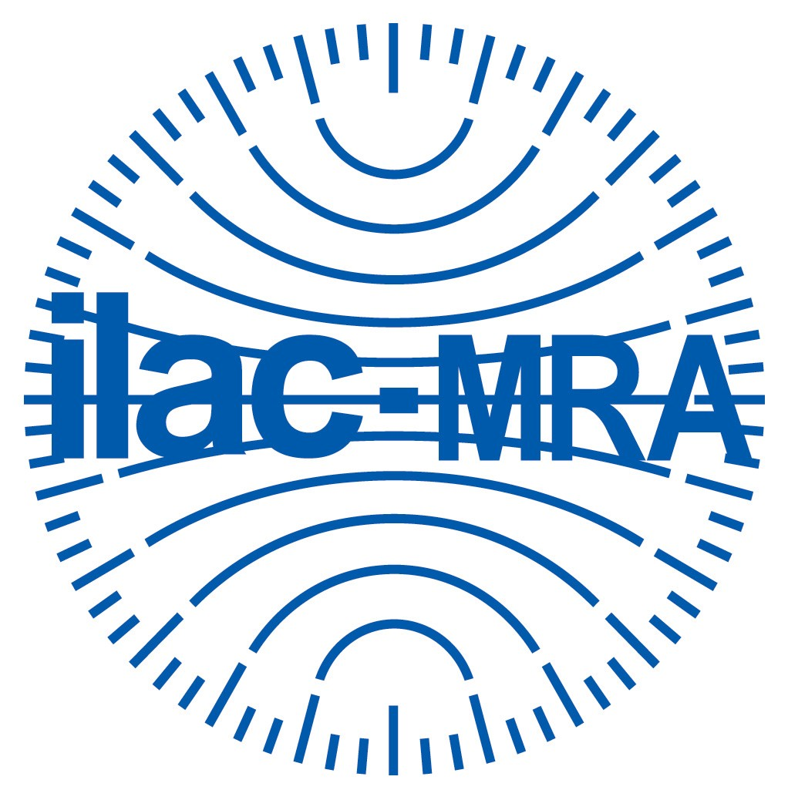
International Linkage
International
International Laboratory Accreditation Cooperation (ILAC)
International Accreditation Forum (IAF)
Pakistan National Accreditation Council

Slide 9
Regional Linkage
Regional
Asian Pacific Laboratory Accreditation Cooperation (APLAC)
Pacific Accreditation Cooperation (PAC)
Pakistan National Accreditation Council

Slide 10
Metrology, Standards, Testing & Quality
National Standard Body
PSQCA
ISO
IEC
National Accreditation Body
PNAC
ILAC/IAF
APLAC/PAC
National Metrology Institute
NPSL
CIPM
APMP
Member
Member
Member
Pakistan National Accreditation Council
Notes:
International Committee for Weights and Measures (CIPM), Asia Pacific Metrology Program (APMP)

Slide 11
Achievements
Mutual Recognition Arrangement (MRA)
Testing and Calibration Laboratories (2009)
Multilateral Arrangements (MLA)
Quality management system (2013)
Environmental management system (2013)
Product Certification (2017)
Pakistan National Accreditation Council

Slide 12
Accredited CABs
Testing and Calibration Laboratories 103
Proficiency Testing Provider 03
Product Certification 01
Certification Body 05
Inspection Body 09
Medical Labs 08
Halal CBs 05
Pakistan National Accreditation Council

Slide 13
One Belt & One Road Initiative
China-Pakistan Economic Corridor
A "game-changer" for Pakistan
A "fate-changer" for entire region
A huge undertaking and important component of One Belt & One Road (OBOR)
Pakistan National Accreditation Council

Slide 14
One Belt & One Road Initiative
Import and Export policy (revising)
For example, acceptance criteria for consignments;
Pre-shipment / post-shipment inspection by accredited IBs
CoC from accredited CBs and
Test reports from accredited testing labs
Pakistan National Accreditation Council

Slide 15
One Belt & One Road Initiative
PSQCA (Regulatory Body)
Accredited by PNAC
Market surveillance through accredited CBs
Only accepts test reports from accredited Labs
Pakistan National Accreditation Council
Notes:
Going towards market surveillance through accredited CABs such as PSQCA is a regulatory body…accredited by PNAC and only accepts results of other accredited CABs

Slide 16
One Belt & One Road Initiative
WAPDA (Regulatory Body)
Accept transformer if tested from accredited Lab
Punjab Agriculture Department (Regulatory Body)
Accept pesticides if tested from accredited Lab
Pakistan National Accreditation Council
Notes:
WAPDA is another body accepting only accredited labs for transformer testing

Slide 17
Future plan
Promote International Cooperation by Focusing on Least Developed Countries (LDCs)
To offer our expertise
To offer accreditation cooperation for;
Testing & Calibration Labs
MoU signed with TURKAK (Turkey)
To expand the scope of cooperation with China
Pakistan National Accreditation Council
Notes:
International Committee for Weights and Measures (CIPM), Asia Pacific Metrology Program (APMP)

Slide 18
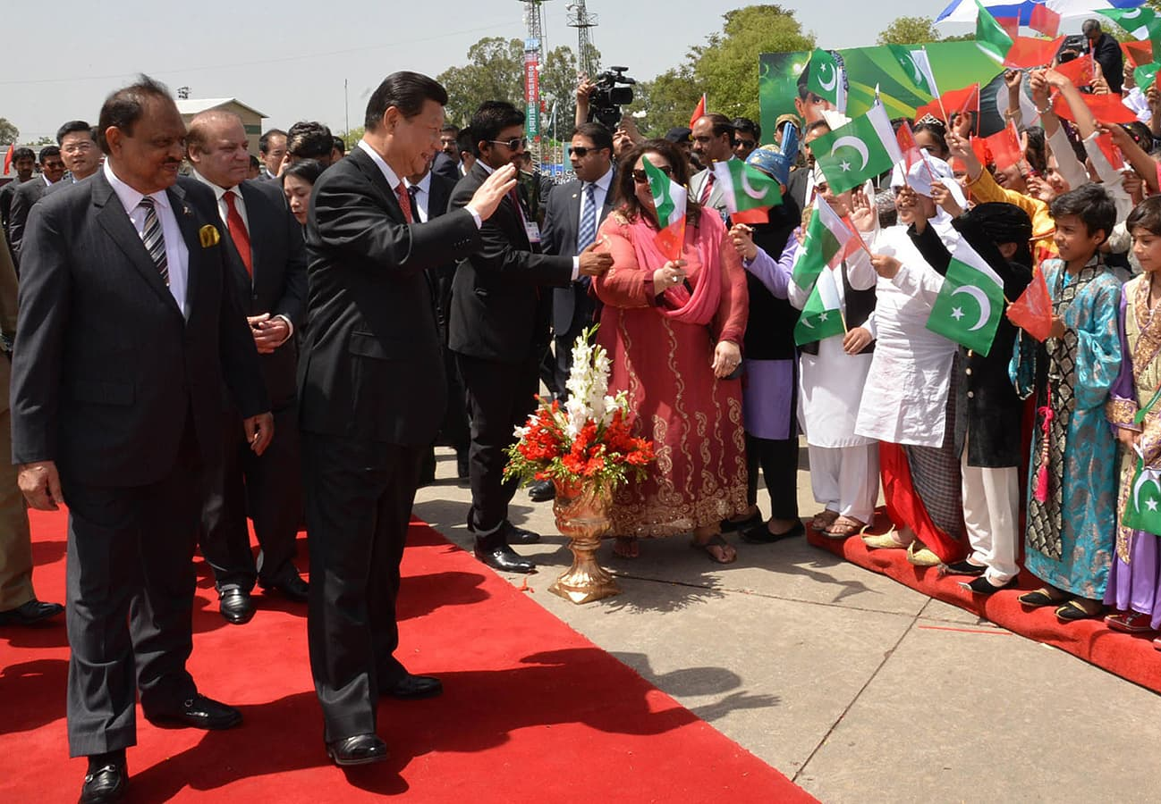
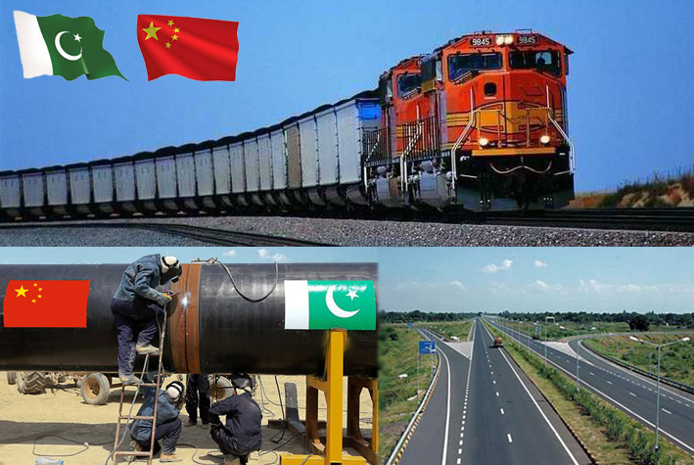

Slide 19
Thanks

