Slide 1

Bangladesh Accreditation Board (BAB)
Presentation on
The Belt and Road
Organised by: CNAS, China
4-15 September 2017

Slide 2

Bangladesh Accreditation Board (BAB)
Accreditation:
Accreditation is a third-party evaluation and demonstration of competence.
Accreditation means increased confidence in the observance of required level of quality of the provided services.
Competence: the demonstrated ability to apply knowledge and skills
Need for national accreditation structure – to facilitate international trade and provide confidence in Conformity Assessment System
Basis of accreditation – International standards, guidelines/recommendations, Policy developed by ISO (International Organization for Standardization), APLAC, ILAC, PAC and IAF

Slide 3
Bangladesh Accreditation Board (BAB)
Established by Bangladesh Accreditation Act, 2006
An Autonomous Body attached to the Ministry of Industries
The National Accreditation Body of Bangladesh

Slide 4
Bangladesh Accreditation Board (BAB)
Constitution of the Board:
1. Chairman, appointed by the Government
2. Secretary, Ministry of Industries, (ex-officio);
3. Secretary, Ministry of Food , (ex-officio);
4. Secretary, Ministry of Commerce, (ex-officio);
5. Secretary, Ministry of Science and Technology, (ex-officio);
6. Secretary, Health & Service Department ,
Ministry of Health and Welfare (ex-officio);
7. Secretary, Concern Ministry/Department in respect of subject matter ;

Slide 5
Bangladesh Accreditation Board (BAB)
8. Two members amongst persons having profound knowledge in the field of science, trade, industry and administration, to be nominated by the Ministry of Industries, of which one shall be a distinguished scientist and the other having higher academic qualification with experience in the field of trade, industry or administration;
9. President, Federation of Bangladesh Chamber of Commerce and Industry(FBCCI);
10. One representative to be nominated by the Vice-Chancellor of Bangladesh University of Engineering and Technology (BUET) at the rank of Professor;
11. Head of a Certification Body to be nominated by the Association of Certification Bodies;
12. Head of a Testing Laboratory to be nominated by the Association of Testing Laboratories; and
13. Director General of the Board, who acts as the Member Secretary of the Board

Slide 6
Bangladesh Accreditation Board (BAB)
BAB Organogram
Director General
Director
Deputy Director
Admin & Finance
Deputy Director
Training & Certification
Deputy Director
Laboratory & Inspection
Assistant Director
Admin & Finance
Assistant Director
Training & Certification
Assistant Director
Testing and Calibration Laboratory
Assistant Director
Medical Laboratory
Assistant Director
Inspection Body

Slide 7
Bangladesh Accreditation Board (BAB)
Approved Manpower : 20
Designation | Number of post | No. of post vacant
Director General | 01
Director | 01
Deputy Director | 03
Assistant Director | 05 | 02
Accountant | 01 | 01
Office Assistant cum Computer Operator | 05 | 02
Driver | 02
MLSS | 02

Slide 8
Bangladesh Accreditation Board (BAB)
The functions of the Board
Accreditation to laboratory, certification body, inspection body, training institution or persons;
Determine and develop the criterion and requirements for accreditation
Establishing Mutual/Multilateral Recognition Arrangement (MRA/ MLA) and with Regional and International Forum
Cooperate with relevant national, regional and international organizations in accreditation

Slide 9
Bangladesh Accreditation Board (BAB)
The functions of the Board
to encourage the concerned persons regarding accreditation and promote the activities of accreditation, arrange training, and organize seminars, symposiums, etc. and take necessary steps for dissemination of information on accreditation;
to appoint assessor on contract basis;

Slide 10
Our Major Area of Accreditation
Testing & Calibration Labs
ISO/IEC 17025
Medical Labs
ISO 15189
Inspection Bodies
ISO/IEC 17020
Certification Bodies
ISO/IEC 17021, 17024 & 17065

Slide 11
How does BAB work?
BAB Quality Management System (QMS) established in line with
  ISO/IEC 17011 and APLAC, ILAC, PAC and IAF guidelines
  National and regulatory requirements
Evaluation of BAB Quality Management System for perpetual quest for excellence
Internal: Internal Audit and Management Review at least once in a year for continual improvement and effectiveness
External: APLAC Peer evaluation within every four year for renewal of MRA status

Slide 12





International Recognition
MRA Signatory 2015
Associate Member 2011
MRA Signatory 2015
Full Member 2014
Associate Member 2007
Membership in process
Full Member 2015
Affiliate Member 2010

Slide 13
International Accreditation picture
IAF
Certification
ILAC
Laboratory & Inspection
.
APLAC
EA
IAAC
ARAC
PAC
AFRAC
SADCA
ILAC International Laboratory Accreditation Cooperation ( 91)
IAF International Accreditation Forum (72)
EA European co-operation for Accreditation ( 38)
APLAC Asia Pacific Laboratory Accreditation Cooperation (39)
SADCA Southern African Development Cooperation for Accreditation (NA)
ARAC Arab Accreditation Cooperation ( not admitted)
AFRAC African Accreditation Cooperation ( not admitted)
IAAC Inter-American Accreditation Cooperation ( 21)

Slide 14

Bangladesh Accreditation Board (BAB)
CONFORMITY ASSESSMENT IN SUPPLY CHAIN
ILAC/IAF
APLAC/PAC
Accreditation Body
BAB
Certification Bodies/ Inspection bodies/Labs
“The Producers”
“The customers”

Slide 15
Regional and International Cooperation
1. Member , South Asian Association for Regional Cooperation (SAARC) Expert Group on Accreditation (SEGA)
2. Member, Standards and Metrology Institute for Islamic Countries (SMIIC)
3. South Asian Regional Standards Organization (SARSO)

Slide 16

Bangladesh Accreditation Board (BAB)
BAB Accredited 52 Organizations as on 17 July 2017
  1.Testing laboratories – 41
  2.Calibration laboratories- 05
  3.Medical laboratories- 02
  4. Certification Body-02
  5. Inspection body -02

Slide 17
Bangladesh Accreditation Board (BAB)
Conformity Assessment Body ( CABs) | Number
Textile testing laboratory | 20
Food testing laboratory | 07
Pharmaceutical laboratory | 04
Petroleum testing laboratory | 02
Chemical testing laboratory | 04
Electrical testing laboratory | 01
Cement testing laboratory | 01
Construction material laboratory | 01
Environmental testing laboratory | 01
Medical laboratory | 02
Calibration laboratory | 05
Inspection Body | 02
Certification Body | 02

Slide 18
BAB Accreditation process
Application Accreditation
Application
Adequacy Audit
Pre-
Assessment/ Assessment
Response & Corrective actions
Granting accreditation
Document review
TRP & TC
According to requirements in ISO/IEC 17011

Slide 19
3 Tier Evaluation
Assessment
Lead Assessor
Technical Assessors
Technical Review Panel (TRP)
Case officer
Technical Committee (TC)
Representative from ATLB / BACB
LA from Assessor pool
External Expert from Stakeholders
Board Member
Tech Experts
Lead Assessor (LA)
Tech Experts from relevant field(s)

Slide 20
Benefits of Accreditation in Bangladesh
@ Service Availability
@ Cost effective
@ More confidence in testing
@ Cheaper rate lab service
@ Foreign currency saving
@ Developed national quality infrastructure
For
CABs
For Consumers
For
Country

Slide 21
Achievements

Slide 22
Achievements of BAB
BAB signed Mutual Recognition Arrangement (MRA) with Asia Pacific Laboratory Accreditation Cooperation (APLAC) and International Laboratory Accreditation Cooperation (ILAC) for testing and calibration in 2015
BAB organized the 5th South Asian Association of Regional Cooperation (SAARC) Expert Group on Accreditation (SEGA) meeting in Dhaka in 2016
BAB signed MoU with Belarus State Centre for Accreditation (BSCA) in 2012 for technical cooperation in accreditation
BAB organized 61 training programs and trained 772 personnel since 2011 (technical trainings to 520 persons and Assessor trainings to 252 persons).
BAB celebrates World Accreditation Day on 9 June every year. Government has declared World Accreditation Day as National day in 2014

Slide 23
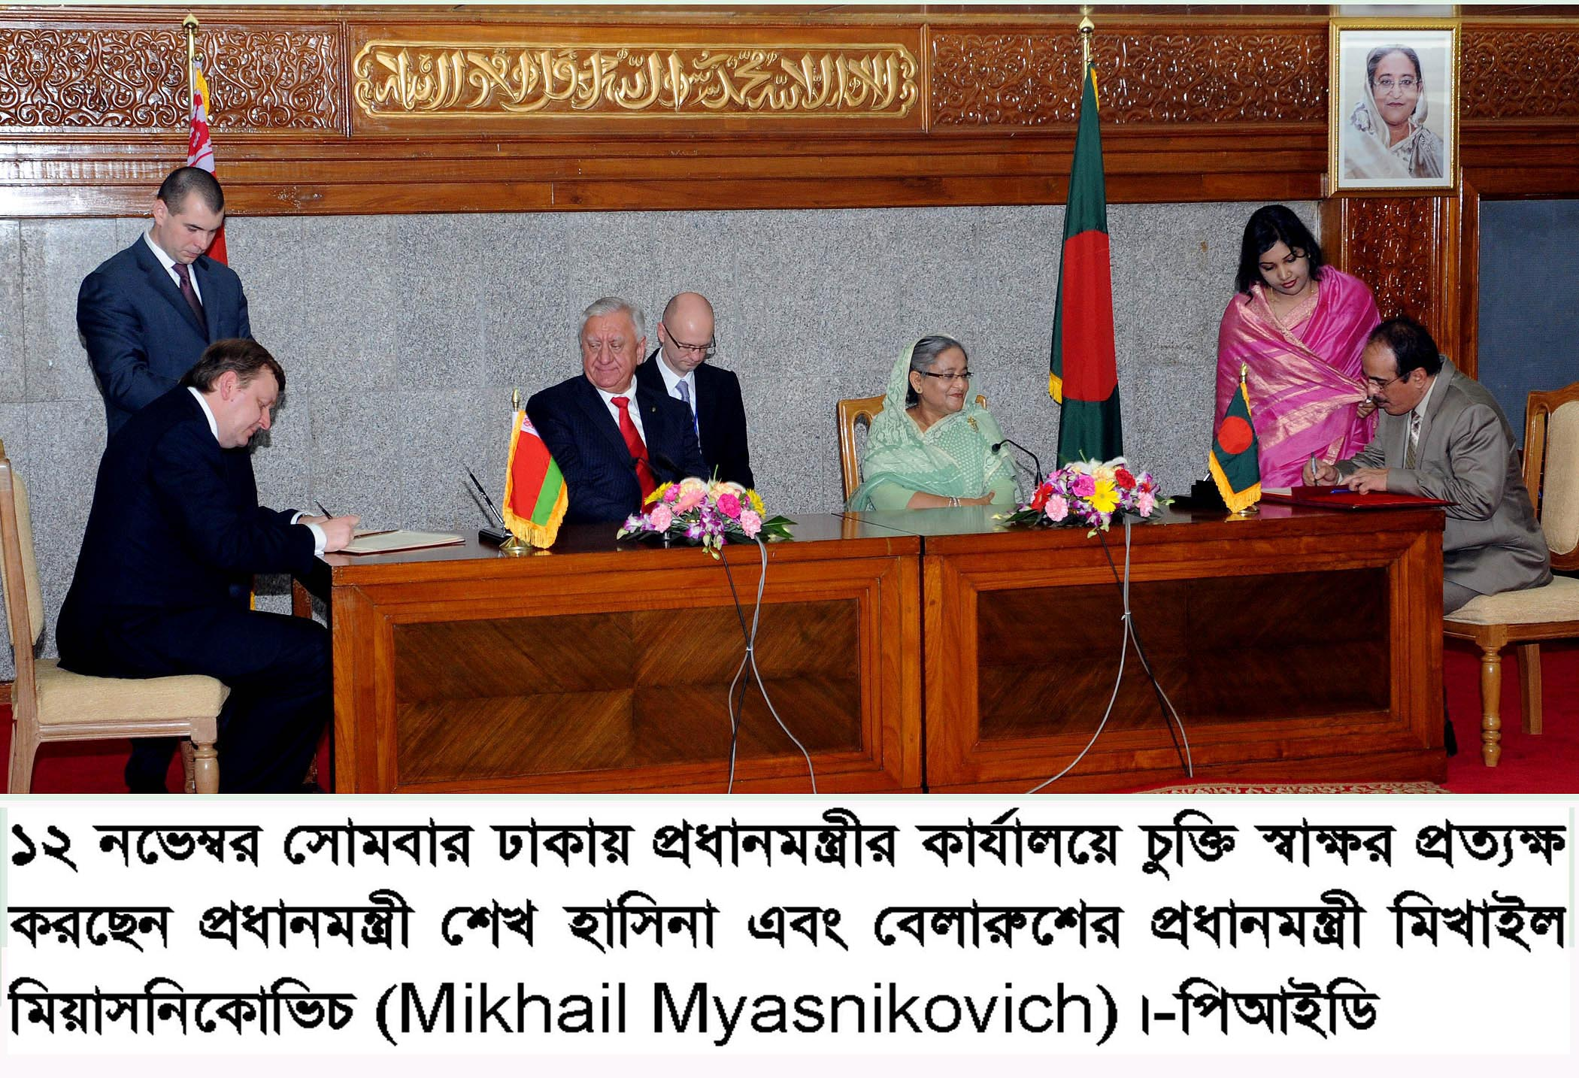
Bangladesh Accreditation Board (BAB)

Slide 24
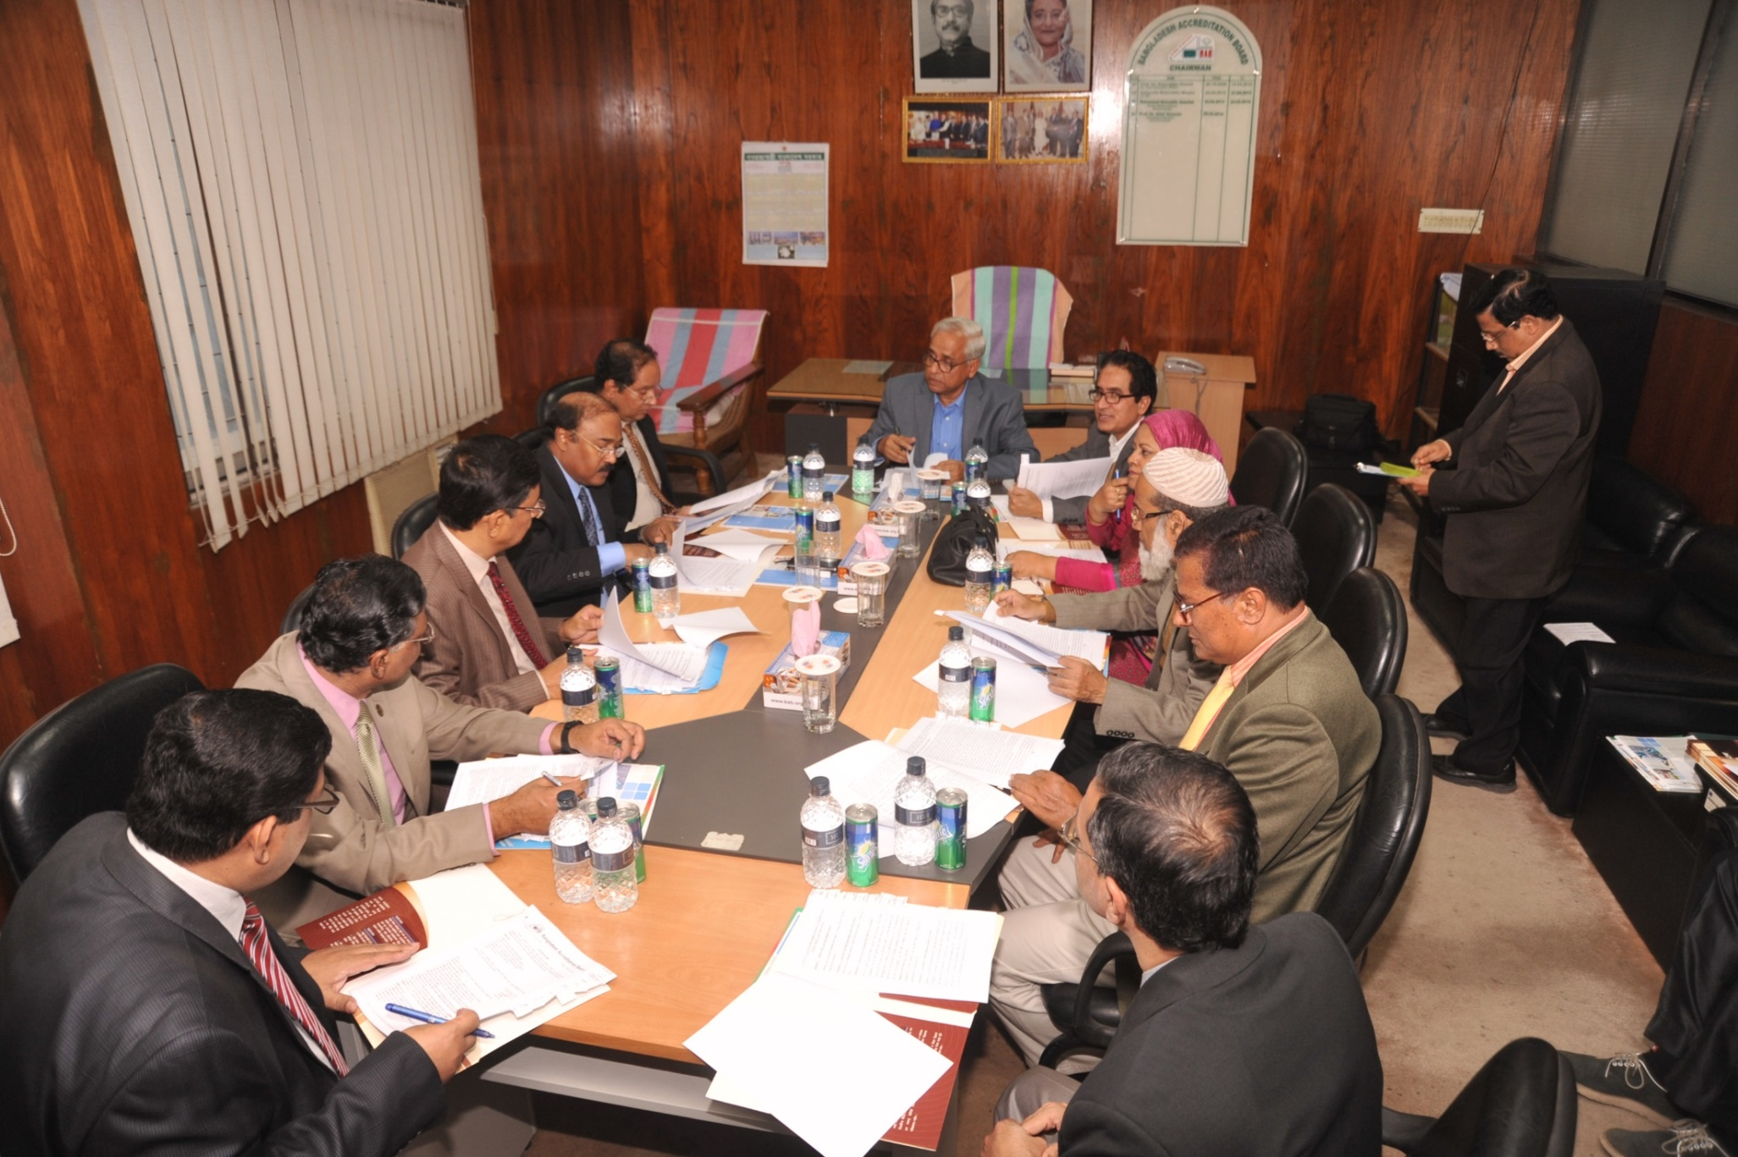
BAB Board Meeting

Slide 25
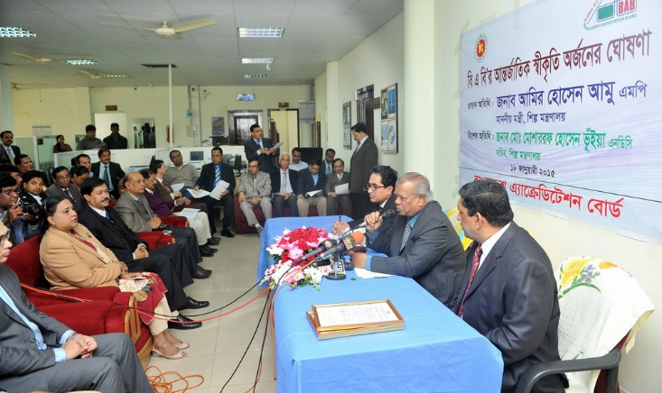

Slide 26
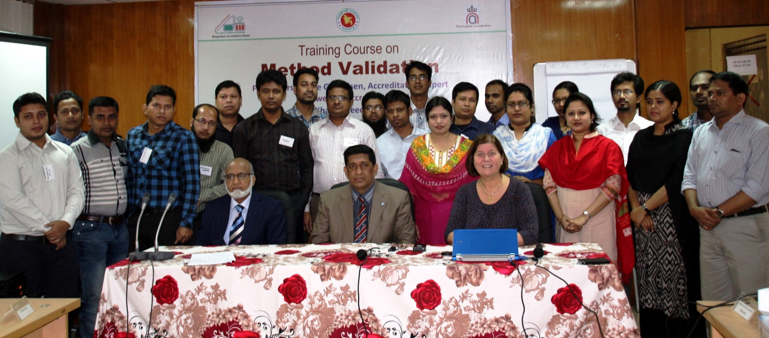
Bangladesh Accreditation Board (BAB)
Participants with resource persons from Norwegian Accreditation (NA) at Training on Method held at Dhaka in 2014

Slide 27

Accreditation
QMS
Standard
THANK YOU
Tested in Bangladesh, Accepted Everywhere

