Slide 1
Country Presentation
Sri Lanka
M R Gunasekara
Hiruni Kumaratunga

Slide 2
SRI LANKA ACCREDITATION BOARD
FOR CONFORMITY ASSESSMENT
(SLAB)
National Accreditation Authority of Sri Lanka.
SLAB established by Act. No. 32 of 2005.
Autonomous body under the Ministry of Science, Technology & Research.
Governed by a Council of 13 Members.
Director / Chief Executive Officer.

Slide 3
SLAB Functions
Grant Accreditation to Laboratories (Testing& Medical), Certification Bodies, Inspection Bodies ,GHG Validation &Verification bodies and GLP
( Collectively referred to as Conformity Assessment Bodies or CAB’s )
Encourage and promote Accreditation.
Facilitate international Co-operation in Accreditation and Gain International Recognition.
Conclude Mutual Recognition Arrangements.
Based Assessment carried out by a team of QUALIFIED and TRAINED Assessors.

Slide 4

Operational Structure of SLAB
SLAB
Certification Bodies
ISO/IEC17021
GHG V/VB
Laboratory
Inspection Bodies
Testing Laboratory ISO/IEC17025
Chemical Testing
Mechanical Testing
Calibration Laboratory
Certification of Product
ISO/IEC17065:2012
Inspection Agencies
ISO/IEC 17020:2012
Certification of Persons
ISO/IEC 17024:2012
Medical Laboratory
ISO15189:2012
Certification of Management Systems
Good Laboratory practice GLP (OECD)

Slide 5
SLAB Accreditation -Current status
Accreditation Scheme | Number of Accredited CABs | Number of Applicant s
Testing Laboratories | 88 | 10
Medical Laboratories | 17 | 03
Calibration Laboratories | 06 | 01
GLP | 00 | 01
Inspection Bodies | 02 | 01
Personnel Certification Bodies | 01 | None
System Certification Bodies | 03(Clients) (QMS,EMS & FSMS,OHSAS) | 02 (QMS)
Products Certification Bodies | 01 (Including 03 Critical locations) | 02
GHG Validation/ Verification Bodies | 02 | 00

Slide 6
International Recognition
SLAB is a full member of the Asia Pacific Laboratory Accreditation Corporation (APLAC) & International Laboratory Accreditation Cooperation (ILAC)
SLAB was admitted as a signatory to mutual recognition arrangement (MRA) of APLAC and ILAC in December 2009.
SLAB has gained full membership status of Pacific Accreditation Cooperation (PAC)

Slide 7
International Recognition of SLAB Accreditation - Current Status
Testing / Calibration / Medical Laboratories /Inspection
MRA Partner of International Laboratory Accreditation Cooperation ( ILAC ) & Asia Pacific Laboratory Accreditation Cooperation ( APLAC )
Systems Certification ( QMS,EMS & FSMS )
MLA partner of International Accreditation Forum (IAF) and Pacific Accreditation Cooperation (PAC)
Products Certification
MLA partner of International Accreditation Forum (IAF) and Pacific Accreditation Cooperation (PAC)
GHG Validation & Verification
MLA partner of International Accreditation Forum (IAF) and Pacific Accreditation Cooperation (PAC)

Slide 8

SLAB Accreditation Logo
ISO/IEC 17025 / ISO 15189/ISO/IEC 17021
TL / CL / ML XXX - XX
ISO/IEC 17021 and ISO/IEC TS 17021-3 QMS/EMS/FMS XXX-XX
ISO/IEC 17025 / ISO 15189
TL / CL / ML XXX - XX
Notes:
06-10 July 2009
SLAB

Slide 9
1.One Belt And One Road Initiative
Sri Lanka played an active role in the ancient Silk route of the ocean
Sri Lanka functioned as an entre port of trade for exchanging commodities.
Efforts of UK and France to connect South Asia, South East Asia, and Far East during colonial times and more recently, the ‘Asian Highway’ proposed by Economic and Social Commission for Asia and the Pacific (ESCAP) are some initiatives taken to develop intra-Asian and Euro-Asian connectivity
More recently, China aims to reclaim the past glory of the ancient Silk Road through its own One Belt One Road initiative and it is one of the boldest initiatives taken by China since becoming the second largest economy in the world.

Slide 10
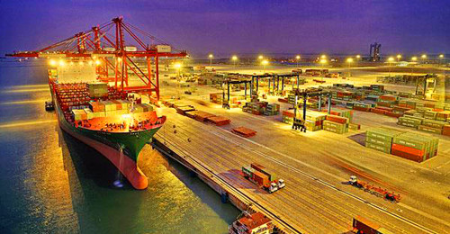

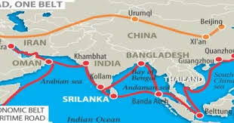

Slide 11
Reinventing the Past Glory: One Belt One Road (OBOR) Initiative
OBOR initiative includes five key cooperation priorities:
policy coordination
connectivity
unimpeded trade
financial integration
people-to-people bonds

Slide 12
Implications for Sri Lanka
China has invested in developing Sri Lanka’s infrastructure and has emerged as one of Sri Lanka’s top 5 investors
the country’s experience with OBOR has been strongly linked to infrastructure connectivity, with less emphasis given to other priority areas of cooperation.
Sri Lanka will benefit from greater information on the OBOR to determine how best the initiative can be translated into concrete outcomes for the country in the years to come.

Slide 13
Legislation and Technical Regulations
National Quality Infrastructure
Government of
Sri Lanka
Sri Lanka Standards
Institution
Sri Lanka Accreditation Board
Measurement Units, Services & Standards Division
Regulatory bodies

Slide 14
2.Use of Accreditation results in Market regulation
  Manley Identification of areas requiring Consumer Protection
For the purpose of identifying the areas in which consumers are to be protected and the regulatory bodies involved, the following analysis was done

Slide 15
TBT & SPS requirements | Areas in which consumers are to be protected | Control body/ Regulatory Authority
Protection of human health or safety | Imports: Cosmetics, drugs (Western medicine) and devices | Cosmetics Devices and Drugs Authority (Ministry of Health) /Dept. of Import and Export Control
 | Homeopathetic drugs | Homeopathic Medicine Council /Dept. of Import and Export Control
 | Telecommunication Equipment | Telecommunication Regulatory Commission /Dept. of Import and Export Control
 | Meat products | Dept. of Animal Production and Health
 | Imported goods, 85 items | SLSI /Dept. of Import and Export Control
 | Local products:Food items | Food Authority/ Commissioner of Internal Trade
 | Other aspects Worker health and safety | Department of Labour
 | Plant safety | Department of Labour
 | Fuel transportation | Ceylon Petroleum Corporation
 | Atomic Energy | Atomic Energy authority
 | Medical Institutions | Ministry of Health
Protection of animal life or health | Veterinary drugs | Dept. of Animal Production and Health
 | Animal Husbandry | Dept of Agriculture
 | Wildlife | Central Environmental Authority
Protection of plant life or health | Forestry | Central Environmental Authority

Slide 16
Laws and regulations are currently requires when accrediting conformity assessment bodies in Sri Lanka
As far as consumer need to be protected from the matters affecting quality, environment, occupational health and safety etc. Therefore necessary accreditation schemes are to be established and maintained.
Accreditation scheme for testing laboratories, has developed for medical laboratories, inspection bodies and certification bodies for systems, products, and persons.

Slide 17
Strengthening legislative framework to facilitate conformity assessment procedures
Present in the country most of the designated institutions are not taking decisions following conformity assessment procedures stated in their acts or regulations.
In most cases many regulatory bodies do deviate from their own legal framework and take decisions following self-developed evaluation procedures.
Therefore it is a pre-requisite to streamline the regulatory framework prior to implementing a sound accreditation system

Slide 18
Analysis of Legislations and Technical Regulations
The Government of Sri Lanka taken decision to include conformity assessment procedure in regulations in 2015 through cabinet paper
SLAB Conducted National Regulatory conclave with all regulators in 2016 covering eight major fields
Health
Food & Agriculture
Constructions
Trade & Consumer Protection

Slide 19
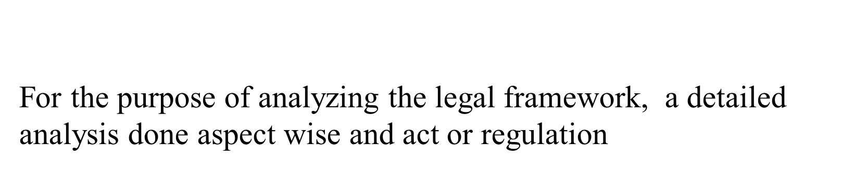
Social care & Security
OHSAS
Energy
Environment

Slide 20
Regulation

Slide 21
Thank You

