Slide 1
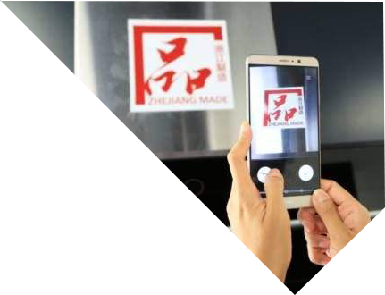
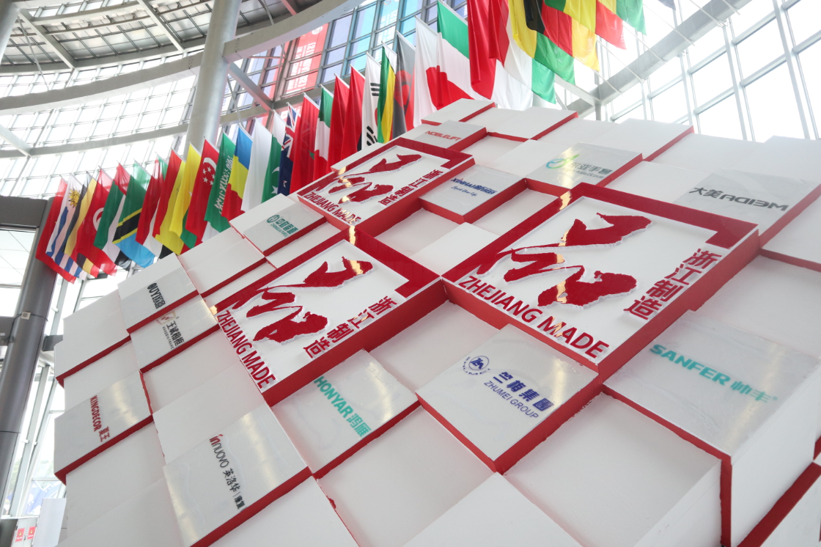
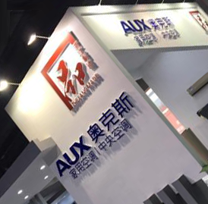
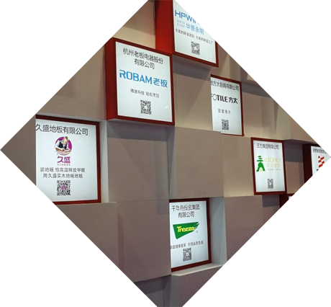
从品质到品牌
Quality to Brand
开启“一带一路”网络贸易新征程
One Belt One Road (OBOR), the New Journey of E-commerce

Slide 2
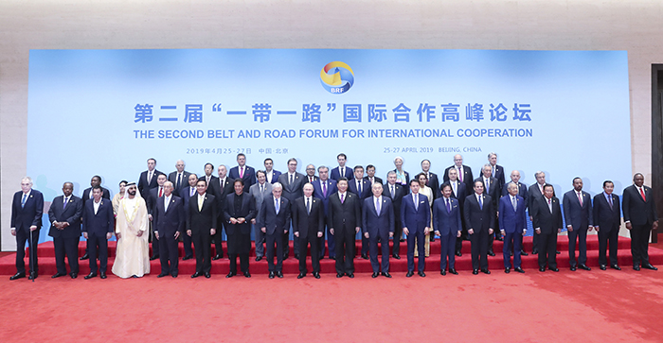
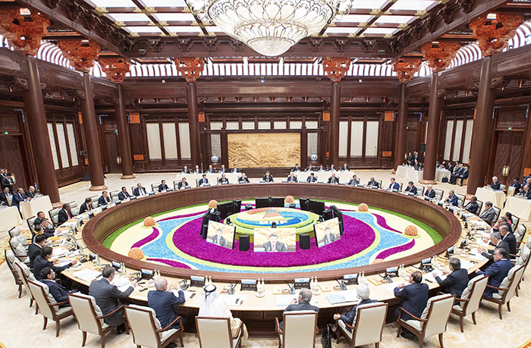
2019年4月25日至27日，第二届“一带一路”国际合作高峰论坛在北京成功举办，开启高质量共建“一带一路”新征程。
From April 25 to 27, 2019, the 2nd 'Belt and Road' International Cooperation Forum was successfully held in Beijing, China
Opening a New Journey of High Quality 'One Belt, One Road’.

Slide 3
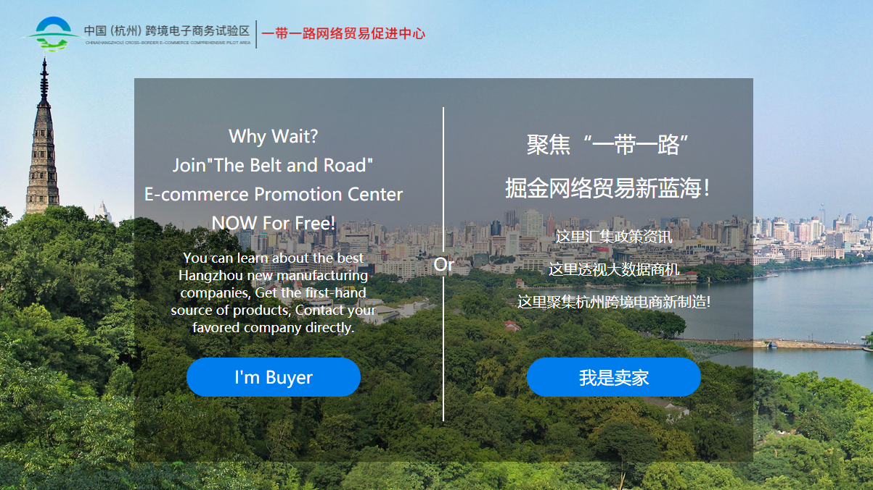
高质量开启“一带一路”网络贸易新征程
High Quality enables‘One Belt, One Road’the New Journey of E-commerce

Slide 4
走“一带一路”，企业不得不面对的巨大挑战
On the 'One Belt, One Road’, the Huge Challenge that companies have to face
在推进“一带一路”网络贸易促进中心建设过程中，我们对300多家外贸企业进行了走访，总结外贸企业开展“一带一路”网络贸易面临的挑战，主要有以下三大方面：
On the way of promoting the construction of the 'One Belt, One Road' network trade promotion center, we have visited more than 300 foreign trade enterprises, and we find three aspects challenges which them are facing on the 'One Belt, One Road'.
市场Market
“一带一路”哪些国家需要我们的产品？Which countries should we choose?
管理Management
品牌Brand
在“一带一路”市场，如何打造品牌？How to build a brand in the 'One Belt, One Road' markets?
对于这些新市场，供应链如何完善适应客户需求？Does supply chain works and fit for customer needs in these new markets？
开拓“一带一路”市场，我们需要什么样的人才？What kind of talent do we need to develop the market of the 'One Belt, One Road'?
我们如何精准、高效地拓展“一带一路”市场？How can we define the market in accurate and efficient way?
如何在当地精准地找到代理商？How to find agents in the local area?

Slide 5
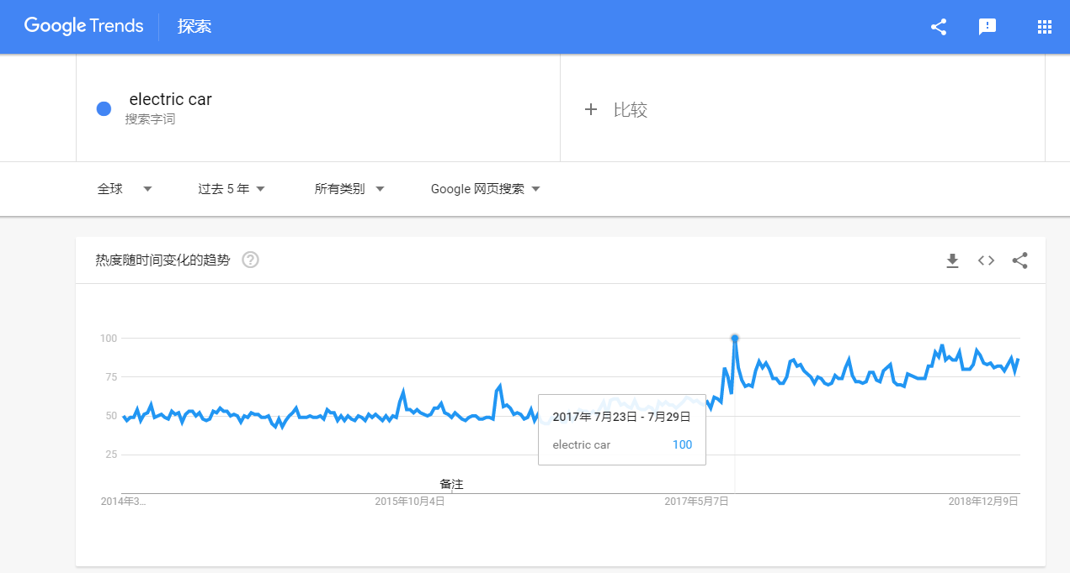
新：通过大数据找到“一带一路”商机
Innovation：Find Business Opportunities on the 'One Belt, One Road' by Big Data
根据过去5年时间Google Trends热度分析：关键字“electric car”（电动汽车）的搜索热度持续走高，尤其在以下国家和地区，这些可以为电动汽车企业开拓新市场提供参考。
According to the Google Trends analysis over the past 5 years:
-The search for the keyword 'electric car' (electric car) continues to rise
-Especially in the following countries and regions
-Which can provide reference for electric vehicle companies to explore new markets.

Slide 6
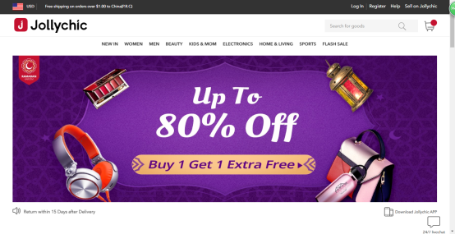
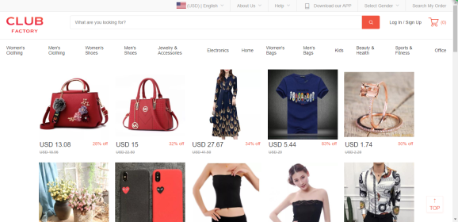
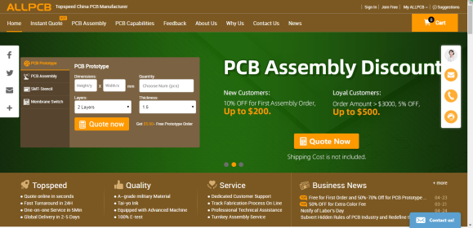
新：促进供应链的持续完善，提升价值
Innovation：Keep improving the Supply Chain,and Add More Value
https://www.jollychic.com
主要成果Outcome ：
移动端购物平台Jollychic自2016年起，就已成为中东地区知名度最高、综合排名靠前的电商应用平台。Since 2016, the mobile shopping platform Jollychic has become the most well-known e-commerce platform in the Middle East.
https://www.clubfactory.com 主要成果Outcome ：
Club Factory是嘉云数据依托人工智能新技术开发的跨境电商B2C平台，目前已成为印度第三大电商平台，平台70％以上成交额来自印度。Club Factory is a cross-border e-commerce B2C platform developed by Jiayun Cloud based on the new AI technology. It has become the 3rd largest e-commerce platform in India. More than 70% of the platform's turnover comes from India.
https://www.allpcb.com
主要成果Outcome ：
2017年6月上线的PCB&PCBA产业互联智造平台allpcb，已经服务超过6万家用户，遍及全球114个国家和地区，其中“一带一路”国家的覆盖率高达80%。The PCB & PCBA industry interconnection intelligent platform ALLPCB, which was launched in June 2017, has served more than 60,000 users in 114 countries and regions over the world. The coverage of the 'One Belt, One Road 'countries is as high as 80%.

Slide 7
新：“浙江制造”走出一条品牌出海之路
Innovation：'Zhejiang Made’, New Way to Become an Oversea Brand
品牌出海
Oversea Brand
OEM/ODM
机会
Opportunities
定价权的机会Opportunities for Pricing Power
新兴企业弯道超车的机会Opportunities for Fair Competition
中国匠人们做自己想做的产品的机会Opportunities for Independent R&D
自由选择市场的机会Opportunities for Free Market Targeting

Slide 8
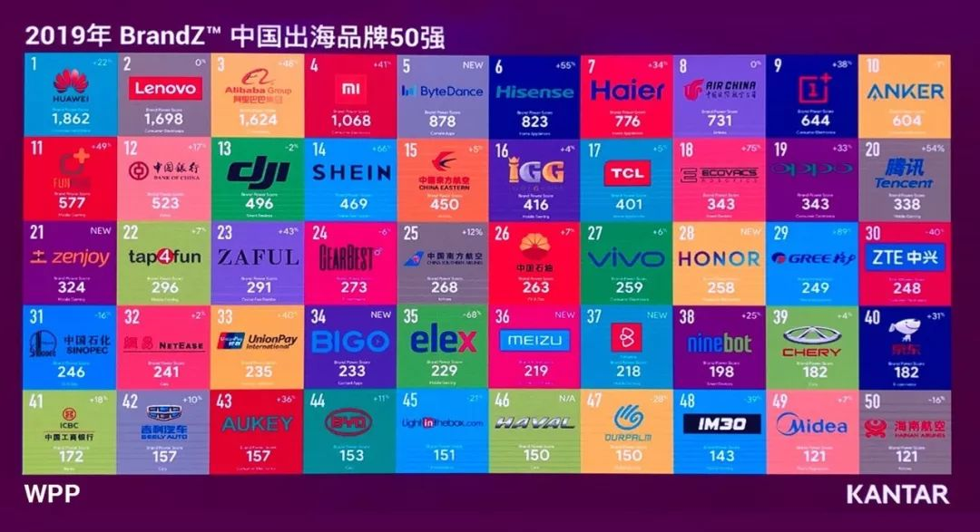
新：“浙江制造”走出一条品牌出海之路
Innovation：'Zhejiang Made’, New Way to Become an Oversea Brand
我们希望未来，有更多“品字标浙江制造”企业荣登“中国出海品牌50强”的榜单！
We hope more ‘ZHEJIANG MADE' companies will be listed on the 'Top 50 Chinese Global Brand Builders' in the future!
品牌力是凯度华通明略的BrandZ品牌资产评估指标，代表消费者选择特定品牌的倾向。The Brand Power is the brand evaluation index BrandZ of WPP and Kantar Millward Brown, which represents the tendency of consumers to choose a specific brand.
品牌力由三个要素构成：有意义（以合适方式满足功能和情感需求）、差异化（具有独特性或引领潮流）和突出性（购买时在消费者脑海中迅速浮现）。Three Elements of Brand Power
Meaningful
- Fit for functional and emotional needs
Differentiation
- Be Unique or Market Leading
Prominence
- Always in the mind of consumers

Slide 9
品质是船 数据是航 品牌是帆
Quality is the Boat Data is the Compass Brand is the Sail
助力“品字标”扬帆远航
Empower to Success of‘ZHEJIANG MADE’

Slide 10
谢谢
Thank You For Your Attention !
李姿lizzy Tel：13819497120

