Slide 1

Accreditation for Trust
强化认证认可，夯实信任根基
2019年世界认可日主题活动
施炳强
UL大中华区政府事务总监
2019 Word Accreditation Day
Benjamin Shi
Government Affairs Director, UL Greater China

Slide 2

信任是经济社会内在诉求 认证认可是有效抓手
Trust via accreditation in Economic society
中国社会“讲关系”反映出人们对信任的普遍追求
Relations in Chinese society reflects people need trust
社会治理和商业活动需要科学和理性的手段
Social governance and business activity requires scientific and rational approach
认证认可是确保市场经济健康运行关键
Accreditation is critical to the healthy operation of a market economy

Slide 3

全球化发展迫切需要加强认证认可服务
Need to enhance Accreditation in Globalization
全球化为各个国家和地区发挥比较优势发展经济提供了巨大机会
Globalization provides huge opportunities for comparative advantages
各种外包分包使得供应链变得既灵活又复杂，不确定性增加
Outsourcing brings flexibility for supply chain but uncertainty increases
认可及合格评定：确保市场对产品服务和品牌的信任
Accreditation to ensure trust on product, service and brand

Slide 4

信息技术改变传统供应链 对认证认可带来新挑战
It changes supply chain brings challenge to accreditation
数字化、网络化、云计算正在改变经济生活和商业模式
Business changing due to digital, internet and cloud computing
虚拟环境扩展导致人们对信任的担忧增加
Concern of trust increasing as virtual world growing
认证认可需要与时俱进
Accreditation needs to keep pace with time

Slide 5
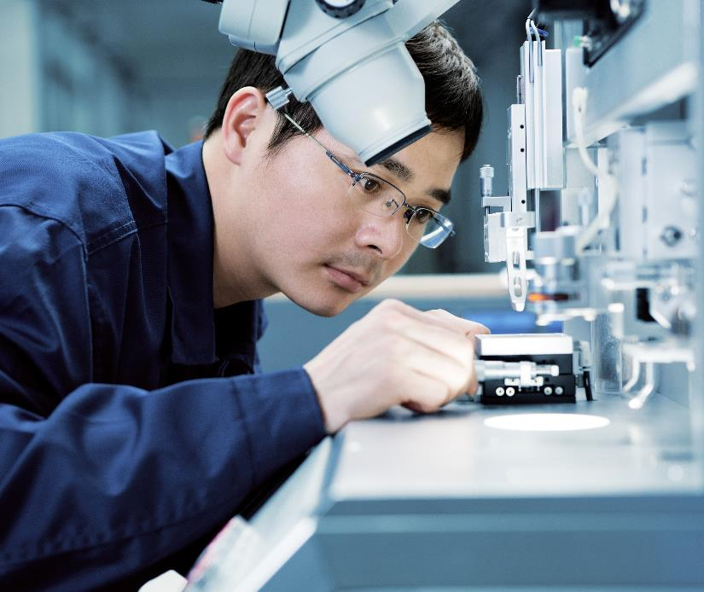
以开放兼容和协同创新发挥认证认可的作用
Open and collaborative innovation for accreditation
认证认可的国际化属性需要开放兼容以利形成共识
Open and inclusive for consensus fits the international nature of accreditation
着眼未来博采众长为认证认可提升供应链价值开辟新境界
Forward-looking and joint work improvs accreditation for better supply chain
动态优化官、产、学、研关系，合理平衡公共服务和商业服务
Optimize relations of gov., indu., univ., and research, balance public and commercial

Slide 6


“浙江制造”认证 践行以开放合作建设区域品牌
zj made cert. , best practice of open collaboration
以认证为抓手，促进本地制造业高质量发展
Certification as a strong tool to drive quality for local manufacturing
以国际认证联盟为主体，协作实施认证
International Alliance as a collaborative carriage for execution
各级政府督促+服务，强化企业质量和品牌意识
Gov. pushing with service to enhance awareness of quality and brand

Slide 7

立足区域、放眼世界、行稳致远
Strengthen at local with world vision and grow steadily
提升浙江制造水平需绵绵用力、持之以恒
Continuous efforts needed for improving Zhejiang manufacturing
以先进标准为基础，不断提升区域性认证品牌的技术水平
Adoption of advanced standards can help bettering this regional certification
政府引领，培育全社会对认证采信的意识和需求
Gov. leads to cultivate the awareness and need for using certification

Slide 8


UL and the UL logo are trademarks of UL LLC © 2018. Proprietary & Confidential.

