Slide 1
认证认可，传递信任，更创造价值
Accreditation for trust, for creation of values

Slide 2
得力集团
Deli Group Company
中国最大的办公产业集团，多工作场景整体解决方案的倡导者与领导者。
The Largest Office Industry Group in China, A Leader and Advocator of One-stop-solution for Diverse & Multi-scenario Working.
得力办公家具
得力集团旗下专业体育用品品牌
Deli sports products brand
得力e+智能办公
Deli e+ Smart Office
政企采购专业电商
Deli Office Brand
Deli Tools Brand
Deli Office Furniture Brand
Professional E-commerce platform and brand for government & company sourcing

Slide 3
增品种 提品质 创品牌
Category expansion, Quality improvement, and Branding
消费升级，供给侧改革
Consumption upgrading，Structural reform of the supply
满足人民群众日益增长的对美好生活向往的需求
To meet the growing demand of people for better life
中国制造向中国创造转变，中国速度向中国质量转变
A transformation from “Made in China” to “Create by China”, from “Grown in speed” to
“Grow with Quality”
以质量持续提升，不断增强大众对国产消费品的品质信任度和品牌认可度
Build up brand identification and credibility through the continuous quality improvement
得力集团践行国家“增品种、提品质、创品牌” 三品战略
Deli Group is committed to practice the Chinese national strategies of “Category expansion, Quality improvement, and Branding”
落实浙江“质量强省 标准强省 品牌强省 浙江制造”规划
Implement the planning of “Zhejiang Province with higher quality, standardization, owning strong brands, and ZHEJIANG MADE”

Slide 4
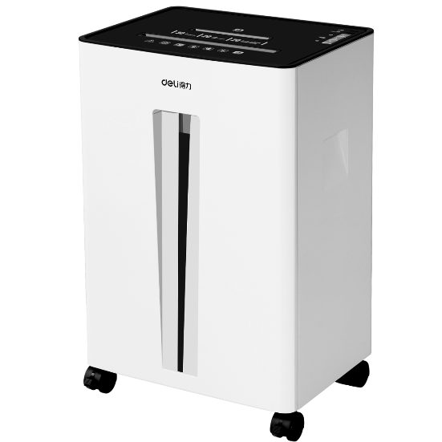
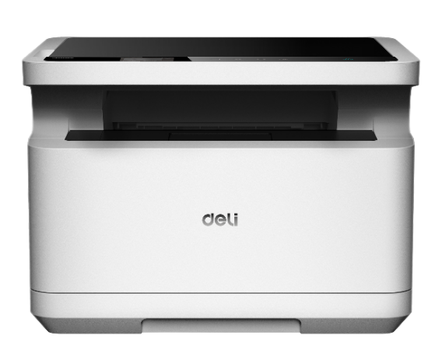
浙江制造 行业标杆
ZHEJIANG MADE, Leader & Benchmark of the industry
离子净碎纸机
云打印机
智能APP保险箱
Shredder emitting air ion
Cloud printer
Safe with APP control
浙江制造通过对标国际一流标准，实施产品认证+企业认证，对标日本制造，德国制造，好产品+好企业的代名词
Benchmarking first class standard globally, like Made in Japan, Made in Germany, ZHEJIANG MADE represent Good Product + Good Company, by accrediting both product and company

Slide 5
浙江制造 行业标杆
ZHEJIANG MADE, Leader & Benchmark of the industry
“浙江制造”成就品类标杆
认证机构
ZHEJIANG MADE as industrial Benchmark
Accreditation Institution
订书机、碎纸机 Stapler, Shredder
电子计算器、手动削笔机机 Calculator, Sharpener
PVP固体胶、档案盒 PVP glue stick, Box file
低噪音高透明胶带 Low noise crystal clear packing tape
液体胶、防盗保险箱 Liquid glue, Safe
.......
得力选择5家不同国际顶尖认证机构， 已获得9张品字标认证证书，充分发挥认证认可“ 体检证”的作用，博采众家之长，不断挑战质量管理极限，增强消费者对“中国制造”的品质信任度与品牌认可度
Deli chose 5 top accreditation agencies, and has already gained 9“ZHEJIANG MADE”, fully delivered the quality proof function of the certificate, breaking through higher quality management standard continuously, strengthening quality and brand credibility of “Made in China”

Slide 6
得力在制造业生根开花
“ZHEJIANG MADE” Roots in Deli
1. 成立得力优品管理委员会，强力推进质量提升工程，增强企业核心竞争力
Deli set up Youpin committee to promote the quality improvement program, strengthen corporate’s core competitiveness
2. 得力优品工程：2019-2020-2021分别30%，50%，70%新产品必须通过优品认证
Deli Youpin program: 2019-2020-2021, we set a goal that 30%，50%，70% of the new products must-pass rate of the Youpin accreditation
3. 到2019年6月，500+SKU 已获得得力优品认证
500+SKU have already gained Youpin accreditation at the end of June, 2019

Slide 7
得力优品认证流程
Deli Youpin accreditation procedure
选择国际品牌对标
Chose international brand as benchmark
项目组评价打分
Quality scoring by quality team
产品创新改进
Product improvement and innovation
得力优品发布
Youpin publication
得力优品项目计划
Deli Youpin program kickoff
对标测试
Test
专家组评审认证
Committee assessment
激励与表彰
Awarding
优标制定发布
Standard publication

Slide 8
成就信任 创造价值
Accreditation for trust, for creation of values
认证是企业质量保证的必然选择，认证证书是企业传递给市场信心的金字招牌
Accreditation is the best choice of quality assurance of a company, and certification is the key to market success
领先的标准，严格的认证，带来可信赖的质量
Leading standard and strict accreditation bring high quality reliability
2018年得力集团收到国家质量监督抽查152次，100%合格
Deli carried out 152 times sampling examination from the national quality supervision in 2018 and we got 100% PASS
坚持第三方监督检测与认证，集团海外5大客户先后授予 “自验资格“
Deli insists to exam and authenticate from the third party, and we are awarded the “self-examination qualification”

Slide 9
成就信任 创造价值
Accreditation for trust, for creation of values
集团营收增长
Deli Group revenue
超过30%
30%+ growth
得力海外营收
Deli Overseas revenue
逐年递增
Keeps growing every year

Slide 10
成就信任 创造价值
Accreditation for trust, for creation of values
宁波市税收贡献排名
Tax amount ranking in Ningbo City
逐年攀升
Rank higher every year
品牌价值一路攀升
Brand Value Grows
位列宁波市第 2 位
No. 2 in Ningbo in 2018

Slide 11
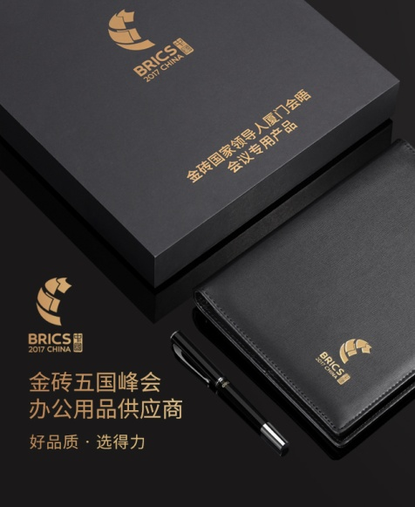
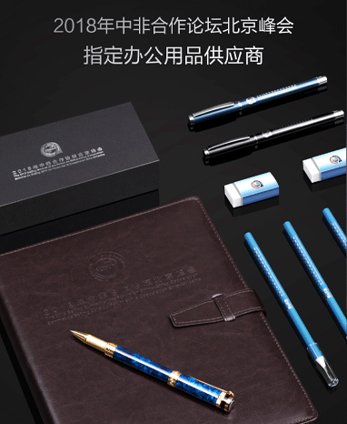
中国品牌 全球认可
Deli, the globally trusted Chinese Brand
北京中非论坛
China-Africa Cooperation Forum 2018
G20峰会
G20 Summit 2016
一带一路国际高峰论坛
RBF Summit 2017
金砖五国峰会
BRICS Summit 2017

Slide 12
质量成就梦想
Dream fulfilled by success of Quality
成为一家值得信赖且受人尊敬的企业
Recognised as a trusted and respected enterprise

