Slide 1
Confirming competence
Providing quality
Creating trust
Accreditation system
in
the Republic of Kazakhstan
Astana, 2017
Notes:
1

Slide 2
National Center
of Accreditation
MISSION and OBJECTS of Accreditation Body
MISSION:
Assessment of the technical competence of accreditation subjects, which provides confidence in the results of testing, measurement, and conformity certificate
Objects:
Ensuring the promotion of goods and services, including exports

Slide 3
Legislative basis of activity
National Center
of Accreditation
Legislative basis
Republic of Kazakhstan Law on Accreditation in the field of Conformity Assessment dated July 5, 2008;
Republic of Kazakhstan Law on Technical Regulation dated November 9, 2004;
Republic of Kazakhstan Law on Measurement Unity Ensuring dated June 7, 2000;
Resolution of the Government of RK 'On Definition of Accreditation Body' dated August 27, 2008 No. 773
SТ RК ISO/IEC 17011-2006 General Requirements for Accreditation Bodies Accrediting Conformity Assessment Bodies;
Documents of ILAC, IAF, РАС and APLAC
Program documents
National program for industrial/innovation development of the Republic of Kazakhstan, 2015-2019
Strategic plan of the Ministry for investments and development of the Republic of Kazakhstan for 2014 – 2018
Comprehensive plan to improve the system of technical regulation and metrology to 2020
Strategic plan of the ’’National center of accreditation’’ LLP for на 2017-2021

Slide 4
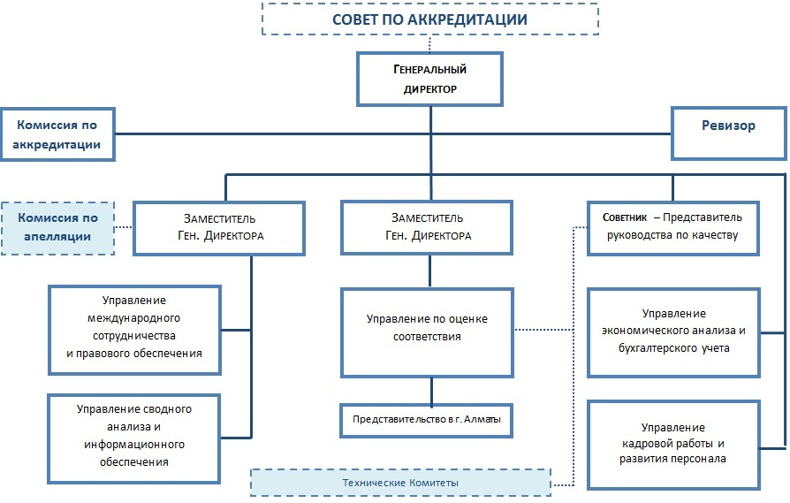
Organizational structure
National Center
of Accreditation

Slide 5
Scopes
National Center of Accreditation
Accreditation:
CB according to GОSТ ISO/IEC 17065-2013
TL according to GОSТ ISO/IEC 17025-2009
VL according to GОSТ ISO/IEC 17025-2009
CL according to GОSТ ISO/IEC 17025-2009
MS CB according to ST RK ISO/IEC 17021-1:2015
Personnel CB according to GОSТ ISO/IEC 17024-2014
Medical laboratories according to ST RK ISO 15189-2008
PT providers according to GОSТ ISO/IEC 17043-2012

Slide 6
Total summary of accredited entities
National Center
of Accreditation
Total number to
August, 2017
1466 accredited entities, including
85 CB and 300 TL
registered to Common Register of CBs and TLs
of Customs Union

Slide 7
Cooperation under the Eurasian Economic Union
National Center
of Accreditation
The Treaty on the Eurasian Economic Union, dated May 29, 2014
FSA Rosaccreditatciya
«NCA» LLP
State Enterprise “BSCA”
«National center of accreditation» of the Republic of Armenia
Kyrgyz center of accreditation
The register of issued certificates of conformity and declarations of conformity issued by CU common form includes
272 755 certificates
454 945 declarations
Common register of CBs and TLs in accordance to Technical regulation of Custom Union includes
85 CB and 300 TL:

Slide 8
International cooperation
National Center
of Accreditation
ILAC –«International Laboratory Accreditation Cooperation»/
APLAC – «The Asia Pacific Laboratory Accreditation Cooperation»
In October 2010, in Shanghai NCA signed ILAC Mutual Recognition Arrangement for testing and calibration
November 2014 – ILAC peer evaluation, confirmation of ILAC full member status
October 2015 – Direction of application on ISO 15189 (medical laboratories)
June 2017 – Accepted as Full member of APLAC and signed APLAC MRA on testing and calibration
September 2017 - Combined assessment is planned (re-assessment and expansion)
IAF/РАС – «International Forum for Accreditation» /«The Pacific Accreditation Cooperation»
June 2012 in Hong Kong (P.R.China) - РАС MLA Arrangement signing
October 2014 – IAF MLA Arrangement signing
March 2015 – NCA passed PAC Peer Evaluation
May 2016 – NCA passed PAC Peer Evaluation on recognition scope expansion on ISO/IEC 17021 и ISO/IEC 17024 standards
June 2017 in Bangkok – scope extension in PAC Multilateral Recognition Arrangement on QMS and Person CB
July 2017 – IAF MLA Arrangement signing on QMS

Slide 9
Trainings
National Center
of Accreditation
Trainings on activity scopes | Training quantity/ participants quantity for 2016 | Training quantity/ participants quantity For 2017
ISO/IEC 17065:2013 Requirements for bodies certifying products, processes and services | - | -
ST RК ISO/IEC 17021:2015 Requirements for MS CB | 8/117 | 1/11
GOST ISO/IEC 17025:2009 General Requirements for the Competence of Testing and Calibration Laboratories | 16/296 | 12/196
ST RK ISO 15189:2005 Requirements for medical laboratories | 4/78 | -
ISO/IEC 17024:2014 General requirements for bodies operating certification of persons | 3/26 | -
ISO/IEC 17020:2012 Conformity assessment. Requirements for the operation of various types of bodies performing inspection | 1/22 | -
ISO/IEC 17043 General Requirements to Proficiency Testing | 1/12 | -
Trainings of experts for conformity assessments bodies | 1/21 | 2/12
Total | 34/572 | 15/ 219
NCA internal personnel: Lead Assessors, Assessors External personnel: Lead Assessors, Assessors Technical experts | 49 76 1058

Slide 10
NCA aims to 2nd half a year 2017
National Center
of Accreditation
Carrying out the accreditation works and monitoring on their activities;
Professional development and personnel preparing. Internships in foreign accreditation bodies.
Development of new directions, accreditation: Inspection bodies; Certification bodies for organic products;
Greenhouse gas validation and verification bodies, Halal production;
Development and Implementation the amendments to legislation in the field of accreditation;
Conduction of regular meeting of the Accreditation Council;
Participation in meetings of regional and international organizations on accreditation РАС, ILAC, IAF, ЕEС, EASC;
Preparation for APLAC Peer Evaluation on expansion for medical laboratories;
Transition to the new version of the standard: GOST ISO/IEC 17025
Media works;
Carrying out works on modernization of information systems for the management of unified registers of conformity assessment bodies and conformity assessment documents to the decisions of the council of the Eurasian Economic Commission of May 10, 2016 № 38, 39, from July 26, 2016 № 88, from January 24, 2017 № 9
Accreditation process automatization:
- Transition to "cloud services" internal information resources MANAGEMENT SYSTEM;
- Register of technical experts online maintaining;
- Implementation of accreditation process based on "1C DOCUMENT FLOW"

Slide 11
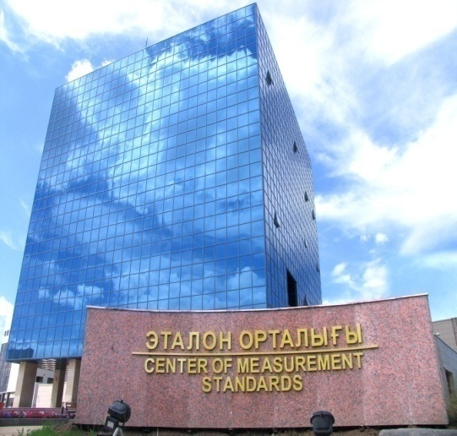
Thank you for attention!

