Slide 1

Native Country’s Introduction
MONGOLIA

Slide 2
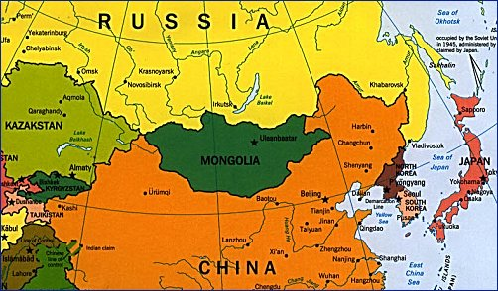
MONGOLIA-Country profile
Population: 3,16mln
Natural Increase: 1.7%
Density: 2 inhab/km²
Urban Population: 72.0%
Official Language: Mongolian
National Currency: Mongolian Tugrik (MNT)
Area: 1,564,120 km²
Type of State: Parliamentary Democratic Republic.
Natural resources: minerals-coal, copper, fluorite, gold, silver, iron, lead, molybdenum, oil, phosphates, tin, uranium, iron and tungestan
Life style: Nomadic civilization up to now in the classic form

Slide 3
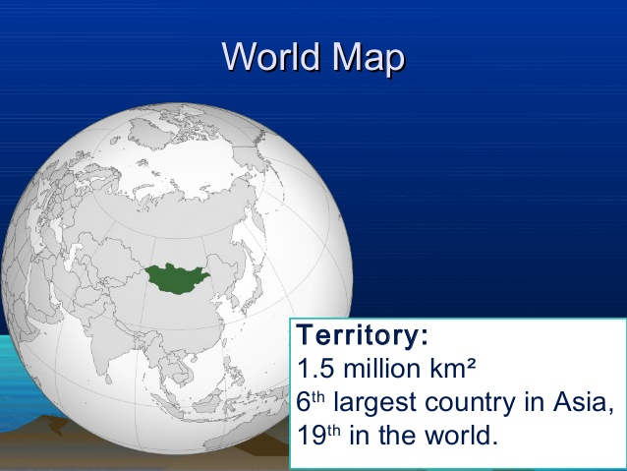
Geography and population
Mongolia is a landlocked unitary sovereign state in East Asia.
It is located between China to the south and Russia to the north.
At 1,564,120 square kilometers (603,909 sq mi), Mongolia is the 19th largest country in the world by land mass and has a population of around three million people.

Slide 4

Language of Mongolia
The official language of Mongolia is Mongolian, and is spoken by 95% of the population. A variety of dialects of Oirat and Buryat are spoken across the country, and there are also some speakers of Mongolic Khamnigan. In the west of the country, Kazakh and Tuvan, both Turkic languages, are also spoken.
MONGOLIAN CYRILLIC ALPHABET

Slide 5
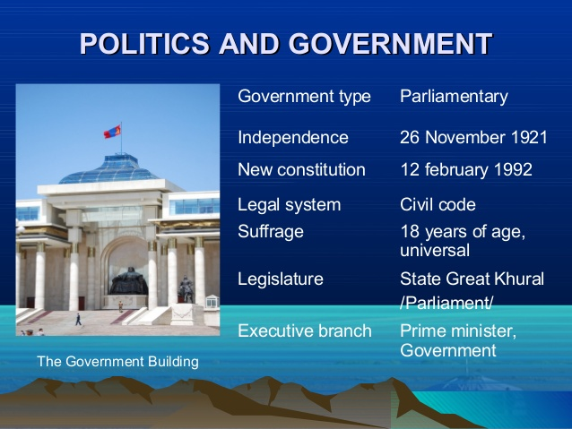

Slide 6
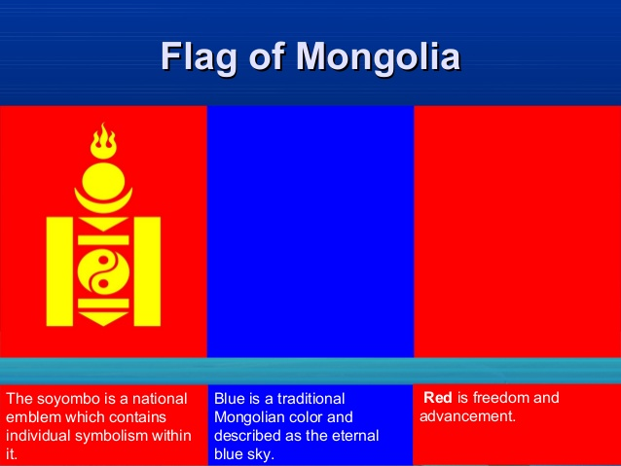

Slide 7
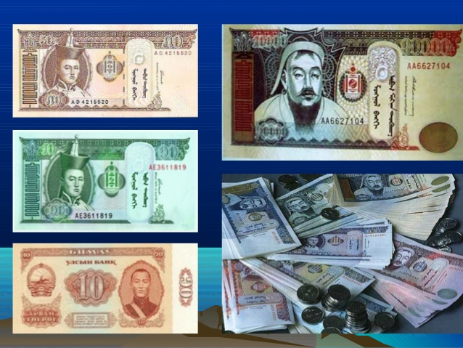
Mongolian currency
Tugrug
The tugrik is the official currency of Mongolia.
sign: ₮
code:MNT
1$ =2400 MNT
1CNY=366 MNT

Slide 8
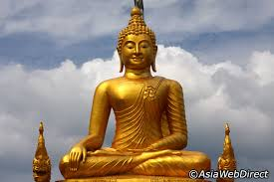
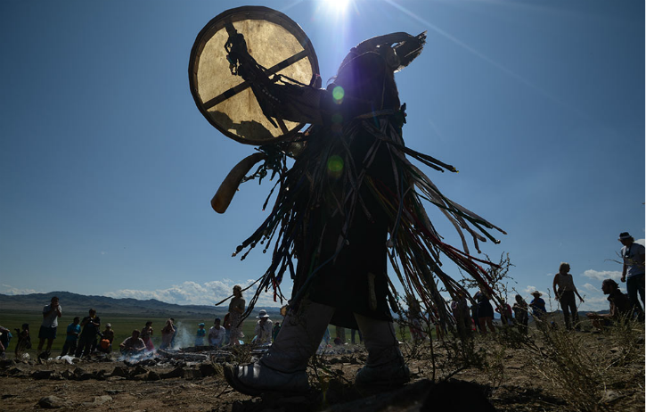
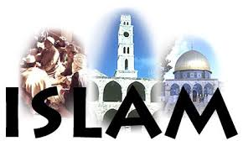

Religion in MongOlia
Religion in Mongolia has been traditionally dominated by the schools of Mongolian Buddhism and by Mongolian Shamanism, the ethnic religion of the Mongols.
According to the national census of 2010,
Buddhists-53%
Muslims-3% (predominantly of Kazakh ethnicity),
Shamanism-2.9%
Cristians-2.1%
not religious-38.6%
Followers of other religions-0.4%

Slide 9
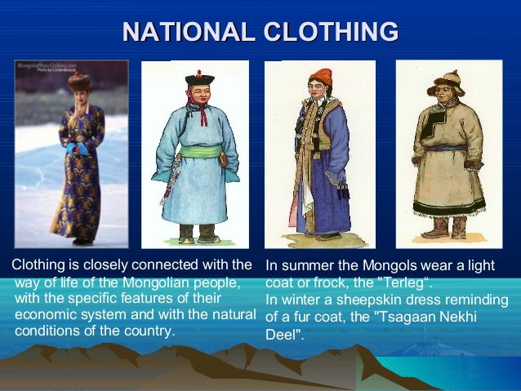
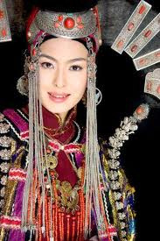
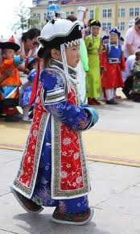
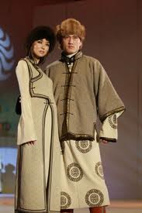
Mongolian national costume

Slide 10
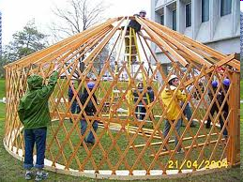
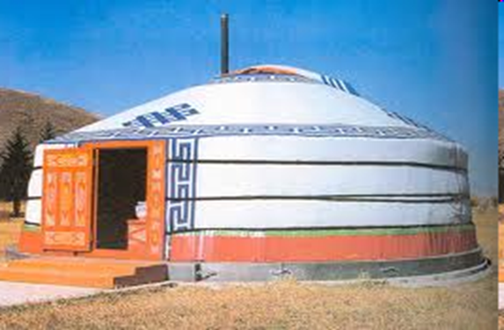
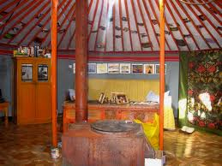
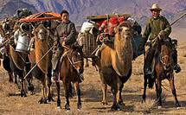
Mongolian traditional ger

Slide 11
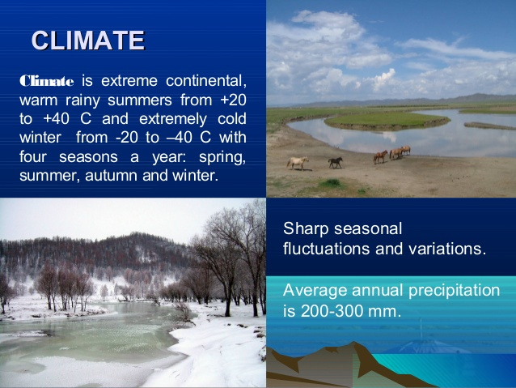
Climate

Slide 12
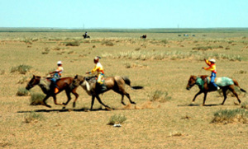
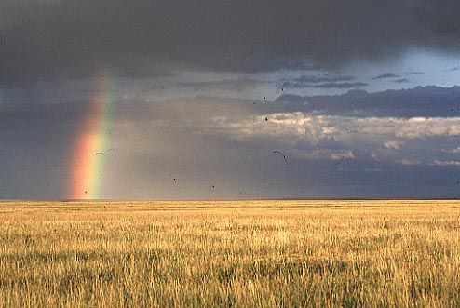
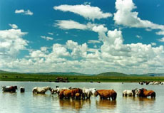
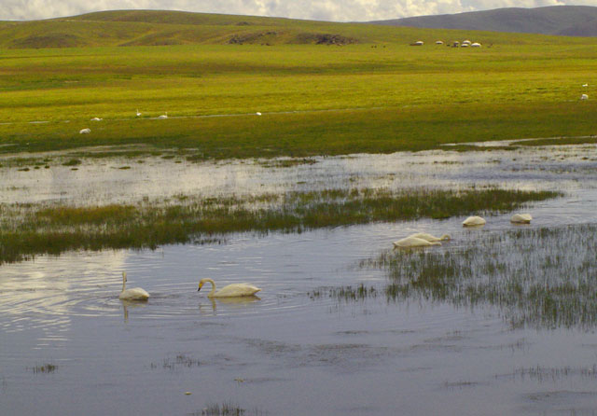
Mongolian steppe’s area
Mongolian nature

Slide 13
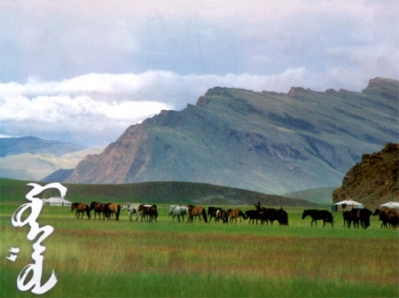
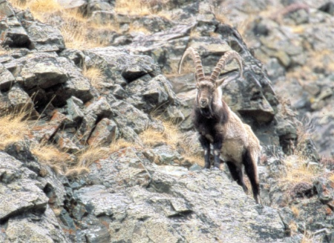
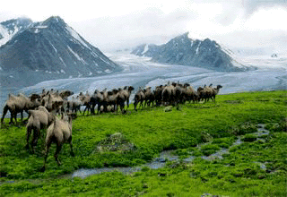
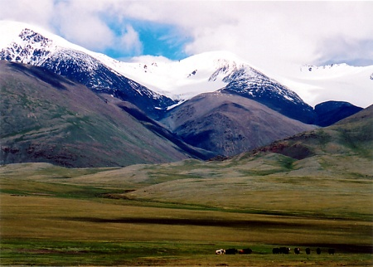
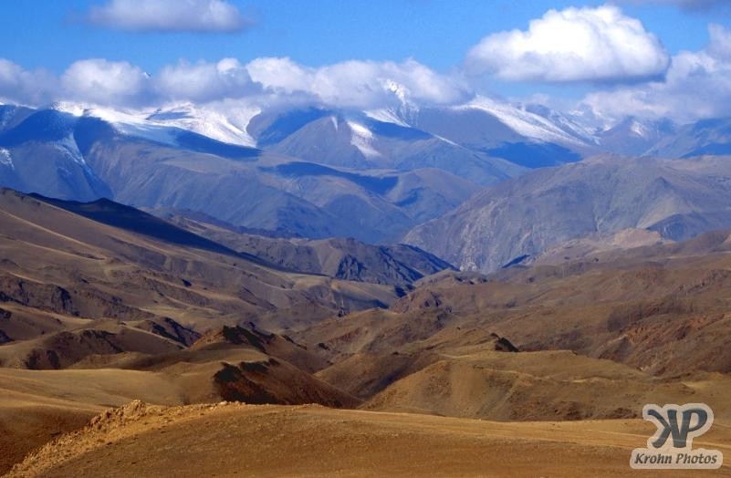
Mongolian nature

Slide 14
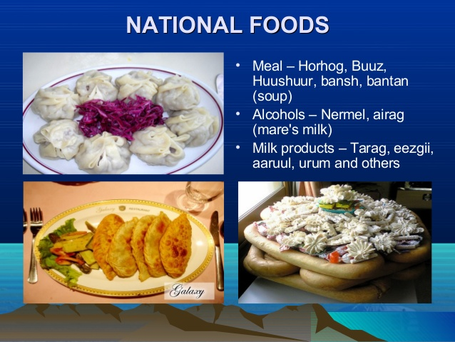

Slide 15
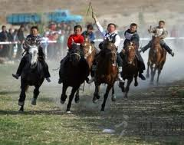
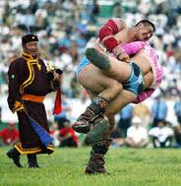
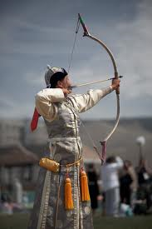
Naadam festival
Naadam is a traditional type of festival in Mongolia. The festival is also locally termed “The three games of men“
The biggest festival is held in the Mongolian capital Ulaanbaatar during the National Holiday from July 11 – 13.
The three games are:
  Wrestling
  Horse racing
  Archery

Slide 16
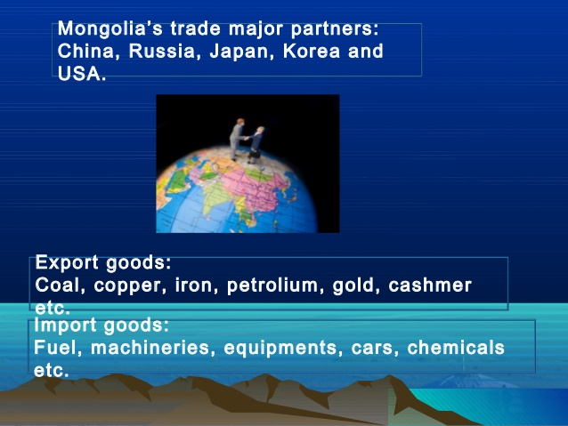
Natural resources
Minerals represent more than 80% of Mongolia's exports, a proportion expected to eventually rise to 95%.

Slide 17
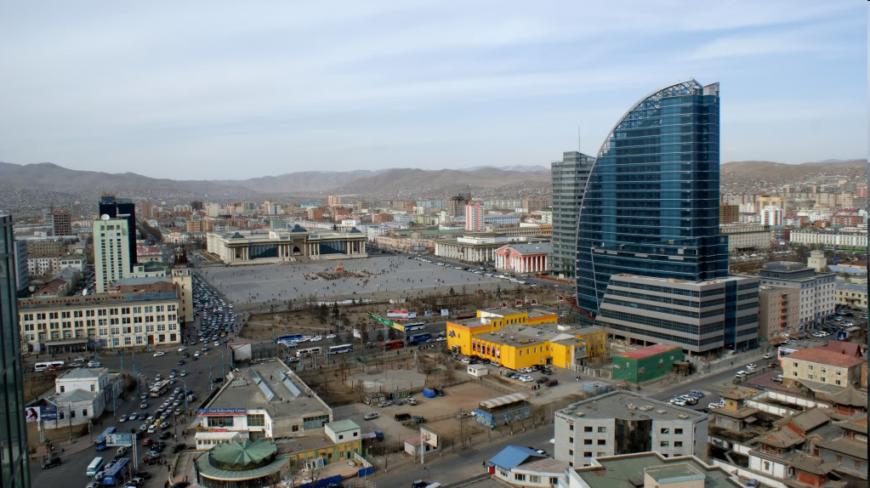
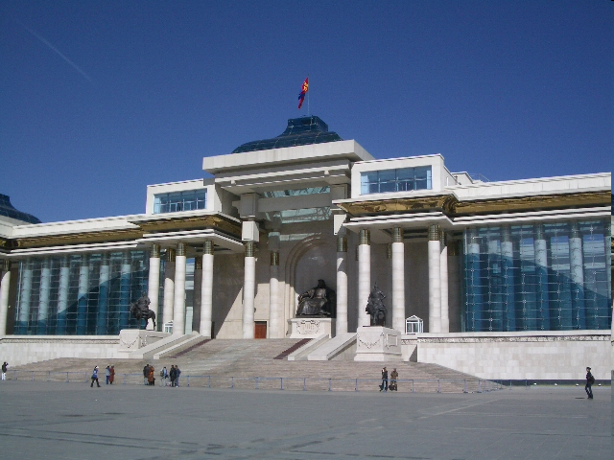
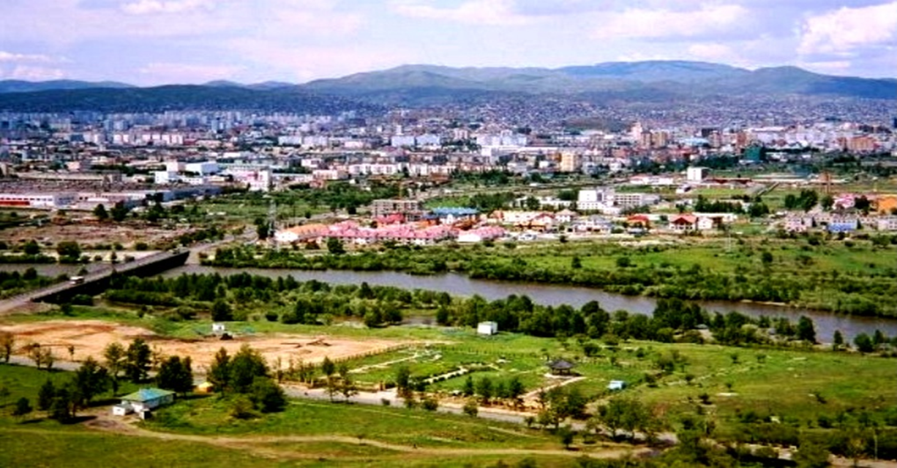
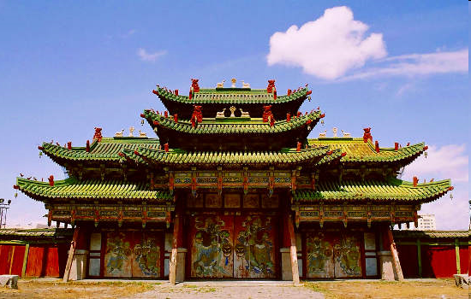
ULAANBAATAR-Capital city
Founded in 1639
Population: :1,372,000
Population density: :272 (people /sq. km)
Coldest capital city (-36-40°C) in the world
Notes:
It is the cultural, industrial, political and financial heart of the country

Slide 18

MNAS
MONGOLIAN
ACCREDITATION
SYSTEM
Current status of accreditation in Mongolia

Slide 19
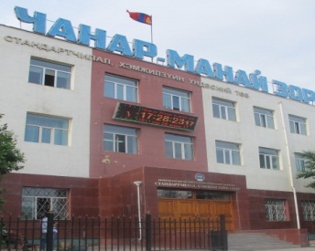
MASM
The Mongolian Agency for Standardization and Metrology - Government Regulatory Agency operating under the Deputy Prime Minister,
Responsible for policy coordinating and managing all activities concerned with standardization, metrology, conformity assessment, accreditation throughout the country.

Slide 20
OBJECTIVE OF MNAS
to establish and develop conformity assessment schemes in Mongolia, and
to achieve mutual recognition arrangements with accreditation bodies abroad,
through which to promote and contribute to the sound development of Mongolian industry and the economy

Slide 21
LEGAL STATUS
Law on Standardization & Conformity assessment (2003)
Law on Measurement uniformity (2003)
Note: The draft law on Standardization and Technical Regulation and Accreditation has submitted to the Parliament (June 2017)

Slide 22
LEGAL STATUS
Law on Standardization & Conformity assessment
Chapter 3, article 13.2:
“ ... The entities referred in the 1st part of the present article to conduct testing, certification and inspection of products that may cause harms to the human health, the environment or the security of nations shall be subject of the accreditation. ....”
Chapter 3, article 13.2 :
“… At the national level, the accreditation shall be performed by the central standardization body ....”

Slide 23
RELATIONSHIP WITH GOVERNMENT
  MNAS offers accreditation services under the authorization of MASM.

Slide 24
MAIN TASKS
To establish and operate the national accreditation system for conformity assessment bodies;
To assess the competence of local applicant CABs, make accreditation decisions, and conduct accreditation-related surveillance and management on accredited conformity assessment bodies;

Slide 25
MAIN TASKS
To assume the responsibility for directing and regulating the uses of MNAS logo and accreditation symbols;
To organize personnel training related to accreditation, and manage the accreditation personnel;
To offer relevant technical services to conformity assessment bodies, and to provide society with publicly available information about accredited conformity assessment bodies;

Slide 26
MAIN TASKS
To participate in international activities related to accreditation;
To deal with appeals and complaints related to accreditation;
To carry out other activities related to accreditation.

Slide 27
ACCREDITATION SYSTEM STRUCTURE
GOVERNMENT of MONGOLIA
Deputy prime minister
MASM
Vice Chair
ACCREDITATION DEPARTMENT (MNAS)
Head
ACCREDITATION BOARD
Appeal committee
Accreditation Technical committees
Accredited CAB’s

Slide 28
ACCREDITATION PERSONNEL STRUCTURE
ACCREDITATION DEPARTMENT (MNAS)
Head
MNAS
Quality manager
MNAS
Staffs
Accreditation Technical committees
Assessors pool

Slide 29
ACCREDITATION PROGRAMS
LABORATORY | Testing Calibration Proficiency testing provider Medical
INSPECTION | Engineering, safety, quantitative
CERTIFICATION | Product Management system Personnel GHG validation & verification

Slide 30
ACCREDITATION CRITERIA
Laboratory | Testing | MNS ISO/IEC 17025:2007
 | Calibration
 | PTP | MNS ISO/IEC 17043:2010
 | Medical | MNS ISO 15189:2015
Certification body | Product | MNS ISO/IEC 17065:2013
 | Management system | MNS ISO/IEC 17021:2015
 | Personnel | MNS ISO/IEC 17024:2013
 | GHG V&V | MNS ISO/IEC 14065:2013
Inspection body | Inspection | MNS ISO/IEC17020:2013

Slide 31

PARTICIPATION IN INTERNATIONAL COOPERATION ACTIVITIES:
2007 Associate member
2012 Full member
June 2012 Signed ILAC MRA
for Testing and Calibration
June 2016 for Inspection

Slide 32

PARTICIPATION IN INTERNATIONAL COOPERATION ACTIVITIES:
2004 Full member
June 2012 Signed APLAC MRA for Testing and
Calibration
June 2016 for Inspection
Notes:
1995.4 首批签署 APLAC谅解备忘录
1999.12 签署 APLAC检测和校准实验室认可互认协议
2004.12 签署APLAC检查机构认可互认协议
2007.12 签署APLAC标准物质/标准样品生产者（RMP）认可互认协议
2007.12 签署APLAC医学实验室认可互认协议
April 1995 Signed APLAC MOU
December 1999 Signed APLAC MRA for Testing and Calibration
December 2004 Signed APLAC MRA for Inspection
December 2007 Signed APLAC MRA for RMP
December 2007 Signed APLAC MRA for Medical Laboratory

Slide 33

PARTICIPATION IN INTERNATIONAL COOPERATION ACTIVITIES:
1995 Member of PAC
June 2017 Signed PAC MLA for QMS, EMS, FSMS, and product

Slide 34
IMPLEMENTING ACCREDITATION of CB PROGRAMMES
Product certification bodies
- 24
Management systems certification bodies - 3
- Quality MS
- Environmental MS
- Food safety management system
GHG VV bodies - 1

Slide 35
IMPLEMENTING ACCREDITATION of LAB ACCREDITATION PROGRAMMES
Testing laboratories - 114
Calibration laboratories – 15
Medical laboratories – 4
Proficiency testing provider – 3
Inspection bodies - 11

Slide 36
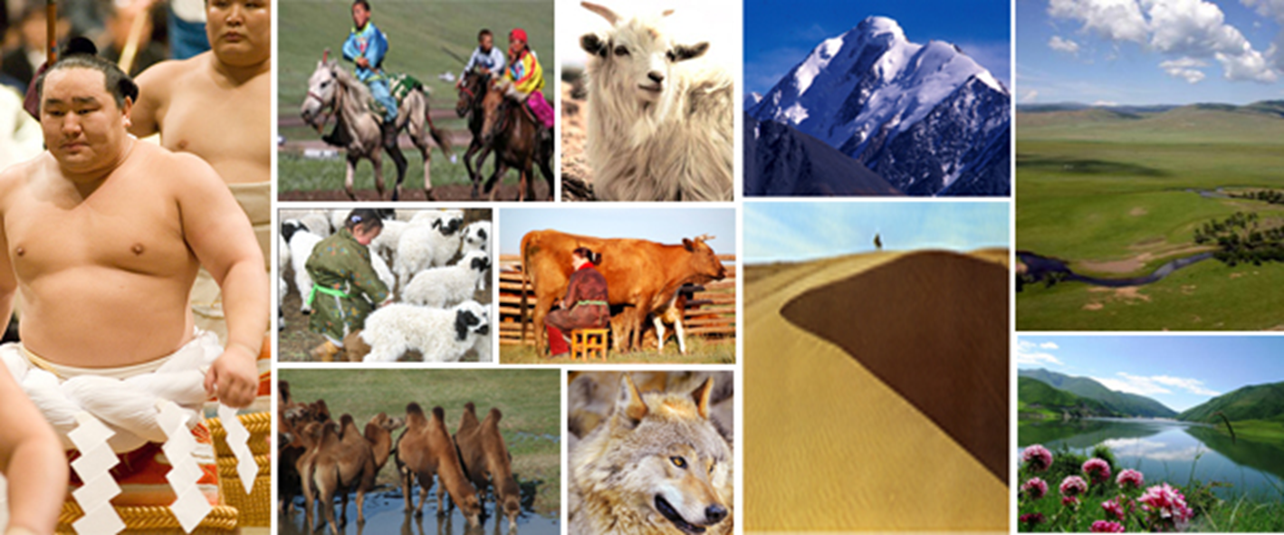
THANK YOU FOR YOUR ATTENTION!
THANK YOU FOR YOUR ATTENTION!
WELCOME TO MONGOLIA!

