Slide 1
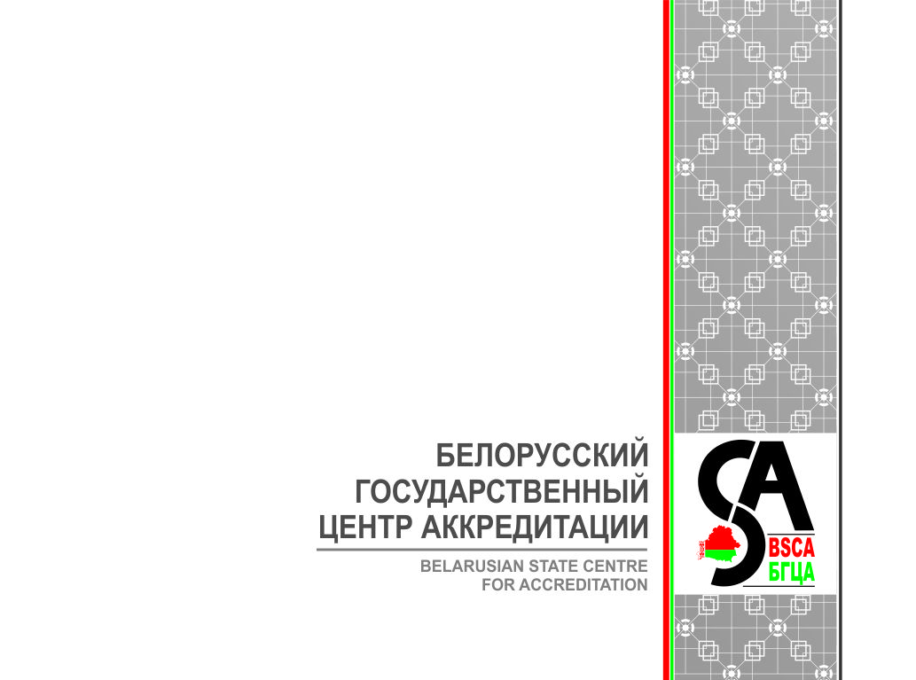
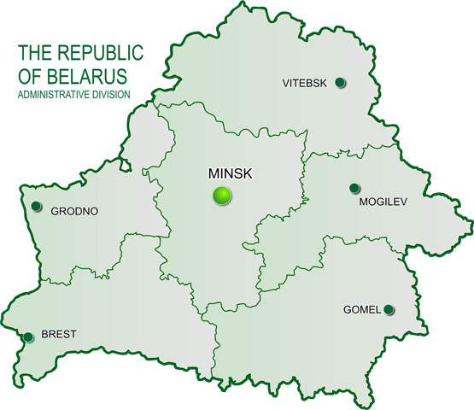
THE NATIONAL ACCREDITATION SYSTEM
OF THE REPUBLIC OF BELARUS
Uladzimir Sharamkou
Alena Biadnarskaya
BELARUSIAN STATE CENTRE FOR ACCREDITATION

Slide 2
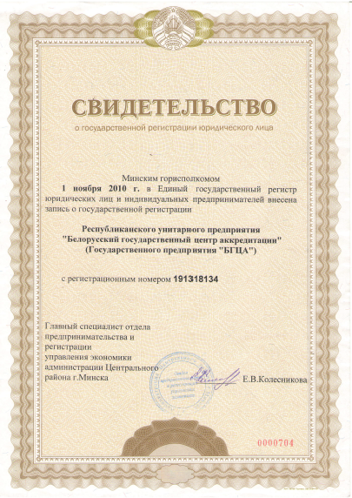
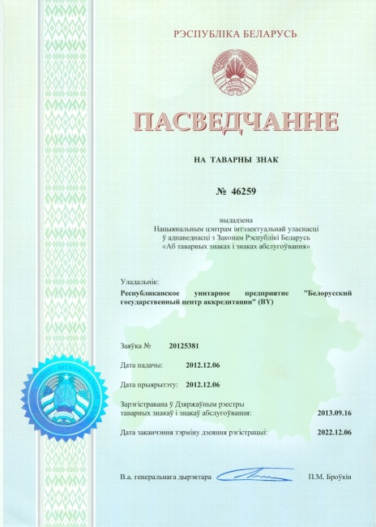

THE NATIONAL ACCREDITATION BODY
OF THE REPUBLIC OF BELARUS
The Republican Unitary Enterprise
«Belarusian State Centre for Accreditation»
Certificate of state registration as independent legal entity No191318134 dated of 16.08.2010
Accreditation body logo
(certificate No 46259 dated of 16.09.2013)

Slide 3

NORMATIVE basis of accreditation
Document
The Law of the Republic of Belarus №437-3 of October 24, 2016 «On assessment for compliance with technical requirements and on accreditation of conformity assessment bodies»
Accreditation Rules included into the National Register of Legal acts of the Republic of Belarus – N 8/24689 of 12 January 2012
ISO/IEC 17011 Conformity assessment - General requirements for accreditation bodies accrediting conformity assessment bodies
Basic standards for conformity assessment bodies
EA, ILAC and IAF documents Mandatory and informative documents, policies and procedures

Slide 4
BSCA STRUCTURE
DIRECTOR
DEPUTY DIRECTOR
ASSISTANT MANAGER
DEPARTMENT FOR CERTIFICATION BODIES ACCREDITATION
DEPARTMENT FOR
INTERNATIONAL COOPERATION
DEPARTMENT FOR
ACCREDITATION ACTIVITIES MANAGEMENT
FRONT OFFICE
DEPARTMENT FOR LABORATORIES ACCREDITATION №1
ACCOUNTING DEPARTMENT
DEPARTMENT FOR LABORATORIES ACCREDITATION №2
LEGAL, HUMAN RESOURCES AND ECONOMIC DEPARTMENT
ADMINISTRATIVE AND MAINTENANCE DEPARTMENT

Slide 5
BSCA ESTABLISHED A NUMBER OF SUPPORTIVE ORGANS:
Impartiality Council
Established to fulfill the requirement of clause 4.3 of ISO/IEC 17011
Technical committees
Advisory bodies which are to give their professional opinions as necessary while decision-making
Technical commission on accreditation
A decision-making body which includes competent BSCA staff members independent of the assessments which are submitted for decision-making
Commission on assessors’ attestation
A supportive organ
which task is to officially conform an applicant assessor is in compliance with the requirements of BSCA documented procedure on personnel
Evolve rules or policies concerning accreditation activities on specific fields
A voluntary association in which all stakeholders are equally represented

Slide 6
Independence and Impartiality of BSCA
Agreement with the Regulator on non-interference into accreditation activity, assessment process and decision-making of BSCA
    BSCA cooperates with Gosstandart as the Regulator in the field of technical regulation and reports to Gosstandart on financial issues
BSCA reports to the Impartiality Council on relations with regulators
Commission on appeals controls the observance of the accreditation rules
Annual risk analysis (RI SM 4.0-2015)

Slide 7
Accreditation activities
Accreditation scheme | Fields of activities
Accreditation of testing laboratories (ISO/IEC 17025) | Accredited laboratories carry out tests of: food and agricultural products; chemical products, fuel construction products; light industry products; engineering products; industrial safety facilities, etc.
Accreditation of calibration laboratories (ISO/IEC 17025) | Accredited laboratories perform calibration in the spheres of following measurements: geometric values, mass, density, physicochemical values, thermo-physical values, etc.
Accreditation of bodies certifying products, processes and services (ISO/IEC 17065) | Accredited bodies certify products: food, construction products, perfume and cosmetics products, oil products, etc.

Slide 8
Accreditation activities
Accreditation scheme | Fields of activities
Accreditation of bodies certifying persons (ISO/IEC 17024) | Accredited bodies certify experts-auditors, energy auditors, personnel in the field of welding, personnel in the field of nondestructive testing
Accreditation of bodies certifying management systems (ISO/IEC 17021-1) | Bodies certifying management systems against ISO 9001, ISO 22000, ISO 14401, ISO/TS 16949
Accreditation of inspection bodies (ISO/IEC 17020) | Accredited bodies carry out inspection of: town planning and design documentation, gaming inflatable equipment, etc.
Accreditation of proficiency testing providers (ISO/IEC 17043) | One application in process

Slide 9
LABORATORIES and INSPECTION BODIES
Currently, the Register of the National Accreditation System of the Republic of Belarus includes:
2618
testing laboratories (centers)
3
inspection bodies
46
calibration laboratories

Slide 10
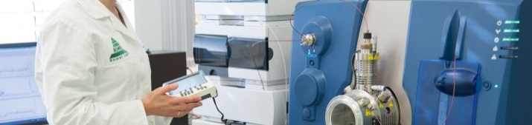
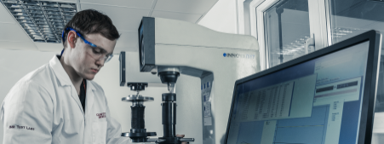
FIELDS OF ACTIVITIES OF TESTING LABORATORIES
Field of activity | TLs | Field of activity | TLs
Food and agricultural products, feed | 539 | Industrial safety (non-destructive testing) | 208
Biological objects, materials and fluids (from animals and humans) | 148 | Pyrotechnic products, explosives, ammunition | 3
Fuel, oil products | 60 | Vehicles, including the UNECE Regulations | 63
Chemical products (except petroleum products and fuel) | 120 | Production of light industry | 187
Construction, furniture production | 407 | Pharmaceutical products | 64
Radio-electronics, low-voltage equipment | 96 | Environmental protection, water supply | 550
Electrical installations, optical equipment | 849 | Occupational Safety and Health | 501
Engineering, machine-tool manufacture | 9 | Other | 383

Slide 11
THESE REGULATORS RELY ON THE RESULTS OF ACCREDITED TESTING LABORATORIES
Regulator | TLs | Regulator | TLs
State Committee for Standardization | 44 | Ministry of agriculture and food | 235
National Academy of Sciences | 47 | Ministry of Natural Recourses and Environmental Protection | 16
Ministry of Architecture and Construction | 144 | Ministry of Trade | 7
Ministry of Housing and Communal Services | 153 | Ministry of Transport and Communications | 91
Ministry of Health | 166 | Ministry of Energy | 196
Ministry of Forest | 35 | Ministry of transport and Communications | 19
Ministry of Defense | 14 | Belneftechim | 88
Ministry of Education | 33 | Bellegprom | 23
Ministry for Emergency Situations | 30 | Bellesbumprom | 20
Ministry of Industry | 154 | Belgospisheprom | 39

Slide 12
CERTIFICATION BODIES
115 certification bodies
certification of products/services
70
certification of management systems
38
certification of persons
6
forest certification
1

Slide 13
FIELDS OF ACTIVITIES OF ACCREDITED
PRODUCT CERTIFICATION BODIES
FIELD OF ACTIVITIES | CB | FIELD OF ACTIVITIES | CB
Individual protection means | 19 | Mechanical engineering | 21
Products for children and teenagers | 29 | Transport, including railway | 13
Packaging | 27 | Petroleum products | 6
Perfume and cosmetic products | 18 | Equipment for work in explosive environments | 7
Toys | 10 | Food products | 26
Pyrotechnic products, weapons | 2 | Construction Products | 32
Light industry products | 27 | Information Technology | 1
Low-voltage equipment | 21 | Furniture and woodworking | 17

Slide 14
FIELDS OF ACTIVITIES OF ACCREDITED
MANAGEMENT SYSTEM CERTIFICATION BODIES
Standard | Certification bodies | Standard | Certification bodies
STB ISO 9001 | 32 | STB ISO/TC 16949 | 2
STB 18001 | 28 | STB ISO/IEC 27001 | 1
STB ISO 14001 | 6 | STB ISO 50001 | 4
HASSP | 17 | STB ISO 13485 | 2
STB ISO 22000 | 9 | STB В 15.004-2009 | 2
*STB – National standards that are identical to international

Slide 15
FIELDS OF ACTIVITIES OF ACCREDITED
MANAGEMENT SYSTEM CERTIFICATION BODIES
FIELD OF ACTIVITIES | CBs
Services in the field of construction, woodworking, furniture manufacturing | 26
Services of hairdressing salons | 19
Dry cleaning services | 1
Laundry services | 4
Services for temporary residence | 14
Catering services | 6
Services for repairing of household equipment | 18
Railway transport services, including transportation | 1
Services for maintenance of vehicles | 18
Services for tourism sphere | 6
Hotel services | 10
Driver training services | 4
Communication services | 1
Ecological services | 1
Logistics services | 1
Real estate services | 1

Slide 16
FIELDS OF ACTIVITIES OF ACCREDITED
PERSONS CERTIFICATION BODIES

Slide 17
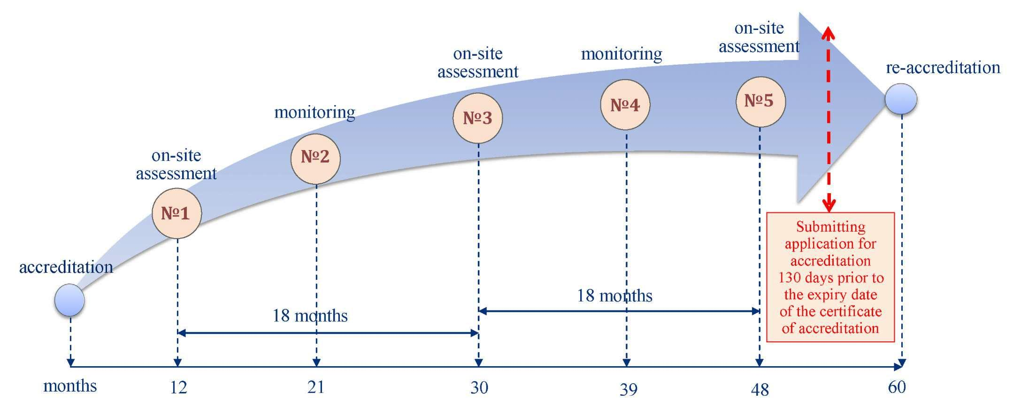
Assessments carried out during the accreditation certificate period of validity

Slide 18


TRAININGS

Slide 19


INTERNATIONAL COOPERATION
EUROPEAN UNION
GLOBAL LEVEL
Peer evaluation is planned for NOVEMBER 2017
PROSPECT
ILAC MRA
EA BLA
PROSPECT
IAF MLA
September 1, 2011
BSCA has been accepted as
ILAC associate member
September 14, 2015
BSCA has been accepted as
IAF member
November 23, 2011
BSCA has been accepted as
EA associate member
Mutual recognition of test reports and certificates
between EU and Belarus
Mutual recognition of test reports and certificates at the global level

Slide 20












REGIONAL COOPERATION
EURASIAN ECONOMIC UNION
(EAEU)
COMMONWEALTH OF INDEPENDENT STATES (CIS)
Armenia
EAEU Common Register
Azerbaijan
Accredited certification bodies and testing laboratories
Armenia
Belarus
Belarus
TREATY on the Eurasian Economic Union
Certification bodies and testing laboratories
Kazakhstan
Draft of
AGREEMENT on
mutual recognition of accreditation
of certification bodies and testing laboratories
Kazakhstan
Kyrgyzstan
Moldova
Russia
Kyrgyzstan
Tajikistan
Mutual recognition of test reports and certificates
Mutual recognition of test reports and certificates
Turkmenistan
Russia
Uzbekistan
Ukraine
  REGIONAL ASSOSIATION of accreditation bodies – CIS members within Interstate Council for Standardization, Metrology and Certification
Mutual peer evaluation in order to achieve equivalence of the procedures applied
Recognition by IAF, ILAC

Slide 21
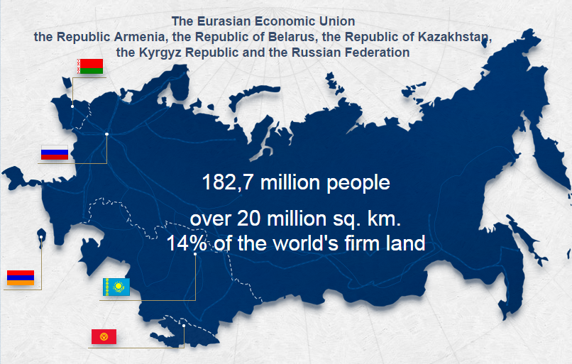
COOPERATION WITHIN THE EAEU

Slide 22
COOPERATION WITHIN THE EAEU
Treaty on the EAEU:
art.54 «Accreditation»
Protocol on the recognition of the accreditation results of the conformity assessment bodies
harmonization of legislation in the field of accreditation
consistency in accreditation and in the activities of accredited CABs
Peer evaluations of the accreditation bodies of the EAEC in order to achieve the equivalence of the procedures applied
Establishment of the Consultative Body for Accreditation in the EAEU - Council of Heads of the Accreditation Bodies of the EAEU
participation in the development of international agreements of the EAEU :
- The Agreement on the procedure and conditions for the removal of technical barriers in mutual trade with third countries

Slide 23
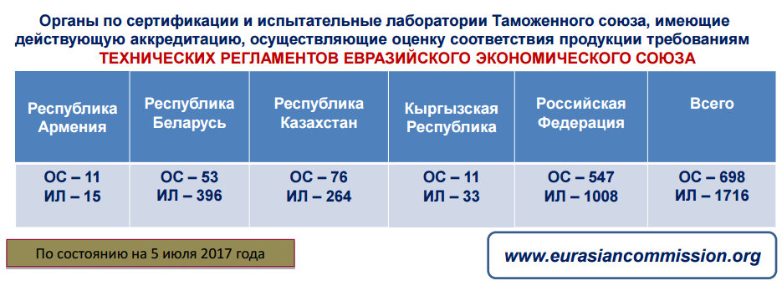
UNIFIED REGISTER OF THE EAEU
Protocol on technical regulation within the framework, p.5:
Accredited conformity assessment bodies that carry out work to assess the compliance with the requirements of the technical regulations of the Union are to be included in the UNIFIED REGISTER of the Union's conformity assessment bodies

Slide 24

COOPERATION WITHIN THE CIS

Slide 25
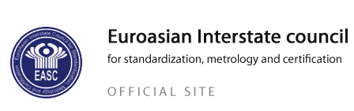
COOPERATION WITHIN THE CIS
Scientific and Technical commission
Working Groups
Meetings of Heads of ABs
Draft Agreement on Technical Barriers to Mutual Trade of the States Members of the Commonwealth of Independent States;
Draft Agreement on Mutual Recognition of Accreditation of Conformity Assessment Bodies

Slide 26



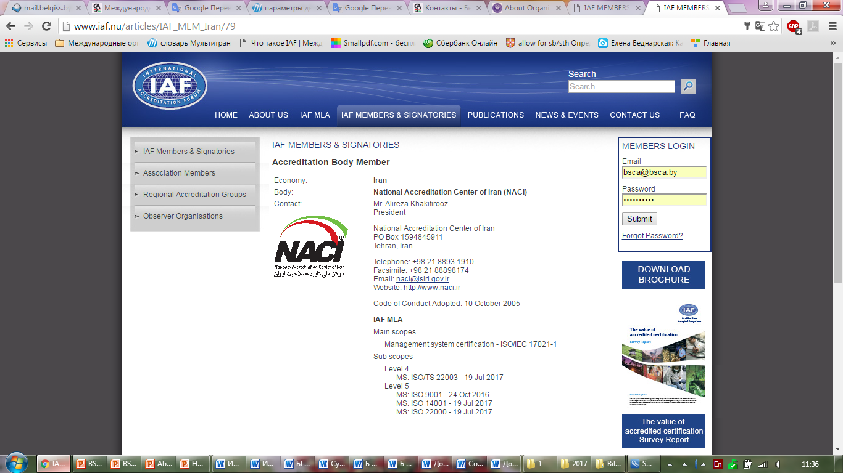
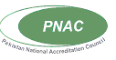


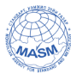





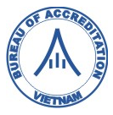





BILATERAL AGREEMENTS ON COOPERATION WITH ACCREDITATION BODIES
PAKISTAN TURKEY LATVIA POLAND LITHUANIA UKRAINE IRAN
EGYPT BANGLADESH KAZAKHSTAN MONGOLIA
BELARUS
SLOVAKIA INDIA VIETNAM
INDONEZIA ESTONIA MOLDOVA RUSSIA SERBIA GEORGIA

Slide 27
Activities under bilateral agreements with ABs
Experience exchange on:
  Performing accreditation of different types in accordance with international requirements, including ILAC and IAF documents
  Training and monitoring of assessors and technical experts
  Proficiency tests and other approaches of ensuring quality of results
  IT services to support interaction among ABs, regulators and CABs
Joint assessments of CABs (in accordance with the rules of cross-boarder accreditation)
Agreeing on terms for recognition of conformity assessment results for delivering mutual confidence between countries

Slide 28

THANK YOU FOR YOUR ATTENTION
and WELCOME TO BSCA!
6 Velozavodskaya Street; 220033 Minsk, Republic of Belarus
е-mail: bsca@bsca.by www.bsca.by

