Slide 1
Information on activity of the Kyrgyz Center of Accreditation under the Ministry of Economy of Kyrgyz Republic
Chapaev Zhanybek

Slide 2
Legislative in base the field of accreditation of the Kyrgyz Republic
Law “On the foundation of technical regulation in the Kyrgyz Republic”
The proposal on the Kyrgyz Centre of Accreditation Centre under the Ministry of Economy of Kyrgyz Republic
Government accepted by of the KR from 05.03.2010г. № 128
The proposal on the national system of accreditation in the Kyrgyz Republic. The proposal on the Council of Accreditation of bodies according to conformity
Government accepted by of the Kyrgyz Republic from 16.11.2006y. № 795

Slide 3
The Kyrgyz Center of Accreditation
under the Ministry of Economy of Kyrgyz Republic
National Accreditation Body of conformity assessment bodies Kyrgyz Republic
Designation authority to formation and introduction national parts of the Unified Register of CB and TL of the Customs Union
Designation authority on delivery:
-uniform blank of certification , appendices within technical regular of the CU,
-Forms certificates, copes, appendices within Kyrgyz Republic,
-Forms of coupons about approval of technical examination

Slide 4
The structure of KCA
Council for Accreditation of CAB
Ministry of Economy of Kyrgyz Republic
Decision Commission on Accreditation of CAB
Kyrgyz Accreditation Center
National Accreditation Body
Appeals and Complaints Commission
Technical Committee for Laboratory Accreditation
(7 sub-committees: microbiology, chemistry, non-destructive methods, metrology, physics and mechanical testing, medical laboratories, forensic activities organizations)
Technical Committee for Accreditation of Certification Bodies
Technical Committee for Accreditation of Inspection Bodies
Involved assessors and technical experts

Slide 5
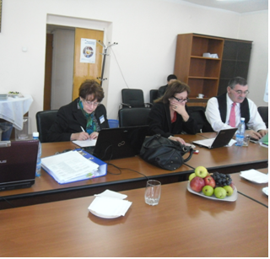
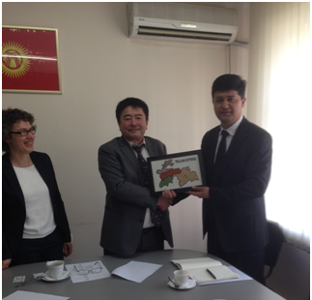
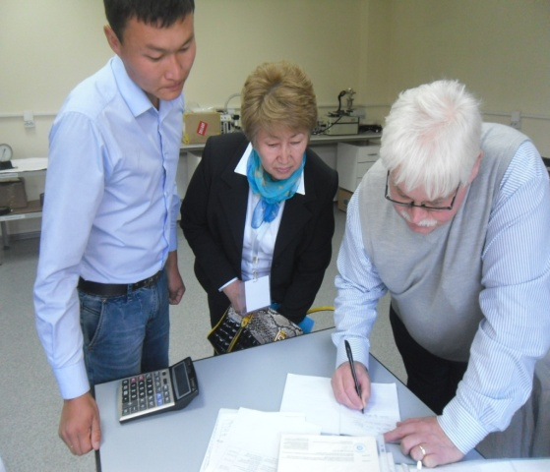
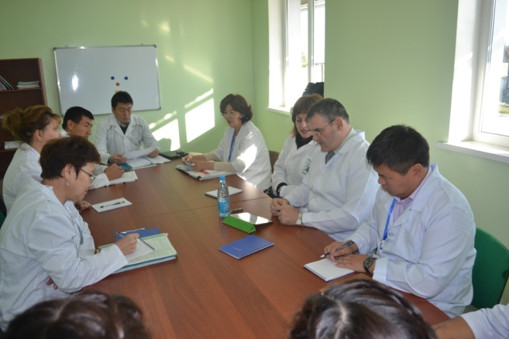
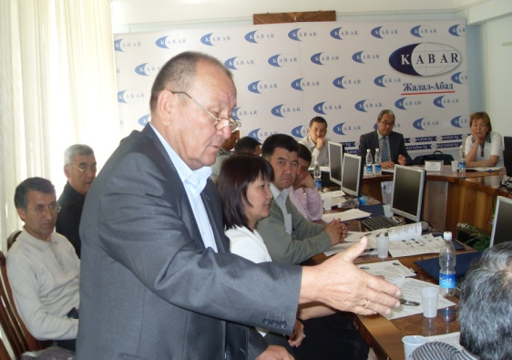
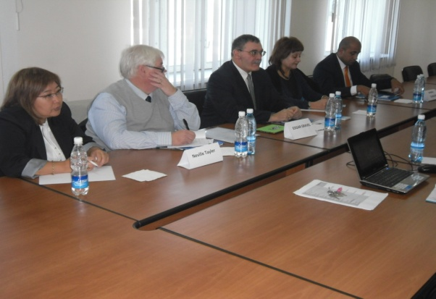
KCA personnel
KCA personnel
staff -15,
Under contract - 3
13 lead assessors
(9 of them KCA specialists)
60 involved assessors
133 involved technical experts

Slide 6
KCA personnel
Personnel of KCA have a necessary skills and technical qualification, high knowledge of operating assessment, it has been noted following the results of 3 assessment from expert groups to ILAC.
Respectively, experts of KCA impart the knowledge and experience to the colleagues from neighboring countries (Uzbekistan, Tajikistan and others).
Also as a matter of experience within the regional organization of accreditation EIC of the KCA development of 2 documents is charged in 2016y.

Slide 7
According to goals and tasks from the moment of creation of KCA (2007)
24 meetings are held the Council of Accreditation of bodies according to conformity
35 meetings TCL,
21 meetings CA,
7 meetings CB
94 meeting on 7 subcommittees TCL

Slide 8
For professional development and competence of expert of CAB in the Republic, KCA had carried out training
on ISO/IEC 17025 «General Requirements for Proficiency of Testing and Calibration Laboratories»
оn ISO 15189 «Medical Laboratories. Quality and Proficiency Subrequirements »
on KMS ISO/IEC 17065 «Conformity assessment. General requirements for bodies of certification systems, process and service.»
on KMS ISO/IEC 17020 «Conformity assessment.
General Criteria for Activities of Inspection Bodies»

Slide 9
According to National strategy development of KR, resolution the Governments of KR work on introduction of the program of electronic document in the KCA, procedure for applications an electronic form for receiving state services and accept to consideration without listing on paper.
Since July 14, 2015 in KCA introduction the system electronic document.

Slide 10
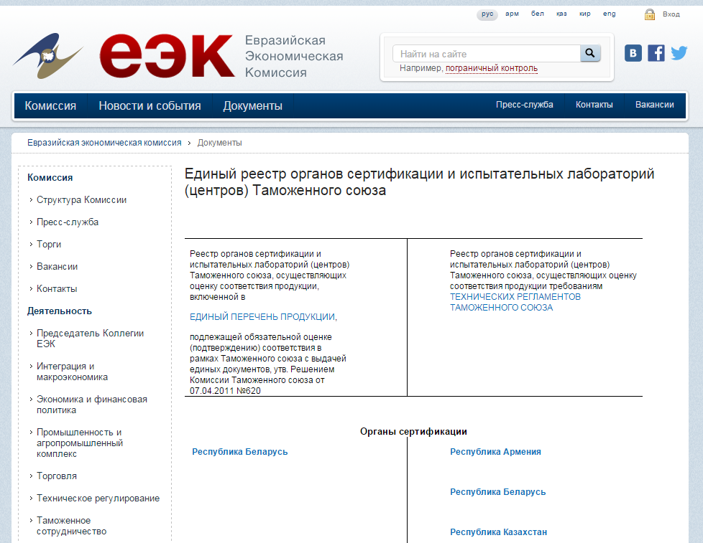
The work of KCA within the framework of the Eurasian Economic Union

Slide 11
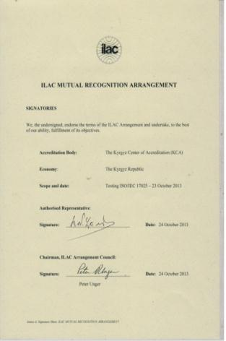
23.10.2013, Kyrgyzstan, represented by KCA
signed ILAC Multual Recognition
Arangement and get status a full member of ILAC on accreditation of Testing laboratories to ISO/IEC 17025.

Slide 12
As a result of the revaluation (October 2014) of the evaluation team of the ILAC set non-conformity on traceability of measurements in the length, force and time
In this regard, the Council for the ILAC Arrangement decided to suspend KCA signatory status in the ILAC the MRA for the accreditation of testing laboratories (ISO / IEC 17025).
Center of standardization and metrology under the Economy Ministry of Kyrgyz Republic jointly with KCA is working on ensuring traceability and implementation of equipment calibration system in the country.
Upon receipt of information on the implementation of traceability in force, length and time will be re-assessed on the spot to verify implementation of ILAC P 10, to enable the Council for the ILAC to consider the recommendation to lifting the suspension

Slide 13
International cooperation
Full member of the International Laboratory Accreditation
Cooperation , signatory of the Agreement on
mutual recognition (status signatory suspended from 04.11. 2015).
Full member Pacific Accreditation Cooperation
KCA represent KR for accreditation the Eurasian Interstate
Council for Standardization, Metrology and Certification
KCA represent KR for accreditation в
Interregional Standardization Association
KCA represent KR in accreditation committee the Standards and Metrology Institute for the Islamic Countries

Slide 14
Memorandum of Cooperation with National
Accreditation Bodies
Republic of Armenia |  | Moldova
Republic of Belarus |  | Russian Federation
Republic of Kazakhstan |  | Ukraine
Bilateral agreement on cooperation with the national accreditation body
Turkish accreditation Agency, Moldova accreditation center, Belarusian state centre for accreditation, Ukraine national accreditation agency, Kazakhstan national centre of accreditation

Slide 15
Accredited conformity assessment bodies
Accreditation subject | Quantities accredited CABs | International standards
Product certification bodies | 13 | ISO/IEC Guide65-2002 / GOST ISO/IEC 17065
Personal certification bodies | 1 | GOST ISO/IEC 17024
Testing laboratories | 92 | GOST ISO/IEC 17025-2009
Calibration laboratories | 4 | GOST ISO/IEC 17025-2009
Medical laboratories | 2 | GOST R ISO 15189: 2012
Inspection bodies | 26 | GOST ISO/IEC 17020-2013
PT Providers | 2 | GOST ISO/IEC 17043-2013

Slide 16
Plans and prospects
Passing revaluation as a full member of ILAC
Conducting work to confirm the compliance of KCA ISO/IEC 17011, ILAC and IAF documents, implementation of the resolutions of the Government of the Kyrgyz Republic
Development and updating of CCA documents, including taking into account the expansion of their activities
Study of the issue of accession to the IAF Mutual Recognition Arrangement (through the PAC)
Evaluating by ILAC for the accreditation of calibration laboratories

Slide 17
KCA plans and prospects
Taking into account the needs of the economy in the Kyrgyz Republic the short term, subject to the direction of the development of the accreditation in accordance with GOST ISO/IEC 17065, GOST ISO / IEC 17025, GOST ISO / IEC 17020, ISO 15189, taking into account relevant international guidelines ILAC and IAF for their application, as well as:
Certification body: food safety management systems (ISO / TS 22003), organic and natural products, certification Halal- products
forensic expert activities

Slide 18
Kyrgyz Center of Accreditation
under the Ministry of Economy the Kyrgyz Republic
address: 720011, Kyrgyz Republic, Bishkek, Frunze str., 421
Web-site: www.kca.gov.kg
E-mail: akkr@kca.gov.kg
Ph/fax: + 996 (312) 43 - 48 - 72
Phone: + 996 (312) 43 - 49 - 18; 43 - 48 - 64; 90 – 20 - 78; 90 – 10 - 39
Director: Zhanybek Chapaev

